Slide 1
Scoreboard with Schedule and Analysis
Project mentor:
Prof. Ankita kanojiya
GLS University FCAIT,iMsc(IT)
Ahmedabad
An application by
Neha Aswani,IM17A2
Trusha Bhavsar,IM17A3
Aayush Ramrakhyani,IM17A44

Slide 2
Contents
App description
Modules
Working of application
Name and logo
Admin side schedule
User side schedule
Admin side scoreboard
User side scoreboard
Analysis

Slide 3
DESCRIPTION
This application is advance version of other application. An application has ability to display the score on real-time basis.It can display scores of games live. The admin can enter schedules and scores of any sport that are available in this. User can able to see the scores as well as can see the analysis of team and players on individual basis. In schedule there is a calendar which shows the current events as well as upcoming events of that days with time. A player form which allows participants to enter their information for further use.

Slide 4
MODULES
1) Scoreboard: - It will be the module which will show the scores of and athletics. Sports admin will update the data.
2) Schedule: - Here, all the schedules of the sports will be displayed with venue and opponent details. If a person clicks on the particular date, the upcoming event will be shown along with the venue, timings and opponent details.
3) Analysis: - Here the analysis of an individual will be displayed based on their performance in matches as an individual and as a team member.
4) Form: - Here application registration form and participation form will be displayed of the sports. User will submit its details and it will then be stored in the database.

Slide 5
MODULES
5) Admin module: - It will be the module which gives some specific rights to specific user to insert data and work with it.
6) User module :- user can login or signup into application and can use and see the data entered by admin.

Slide 6
UML Diagrams
The Unified Modeling Language(UML) is a general-purpose,development,modeling language in the field of software engineering that is intended to provide a standard way to visualize the design of system.
Types of UML Diagrams
Class diagram
Activity diagram
Use case diagram
Sequence diagram
State chart diagram

Slide 7
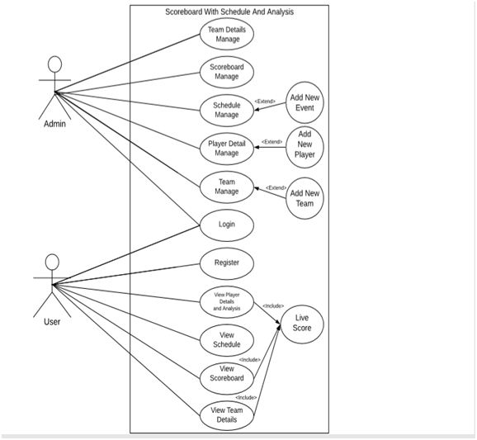
USE CASE DIAGRAM

Slide 8
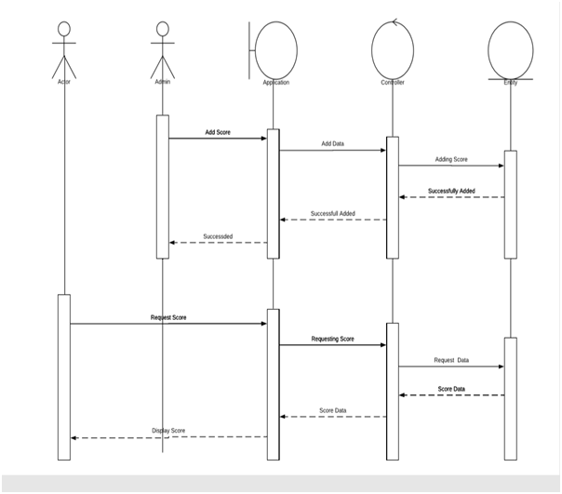
SEQUENCE DIAGRAM OF SCOREBOARD

Slide 9
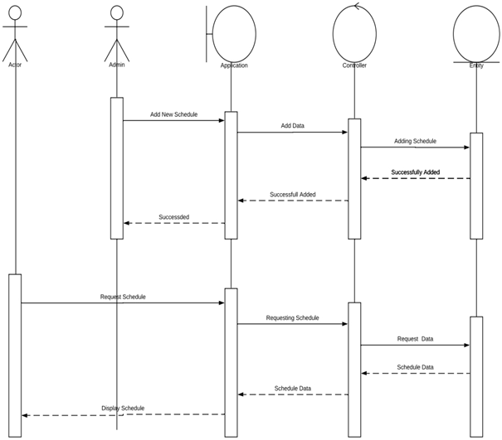
SEQUENCE DIAGRAM OF SCHEDULE

Slide 10
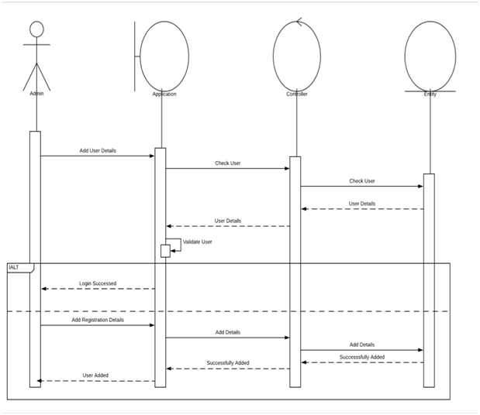
· SEQUENCE DIAGRAM FOR LOGIN

Slide 11
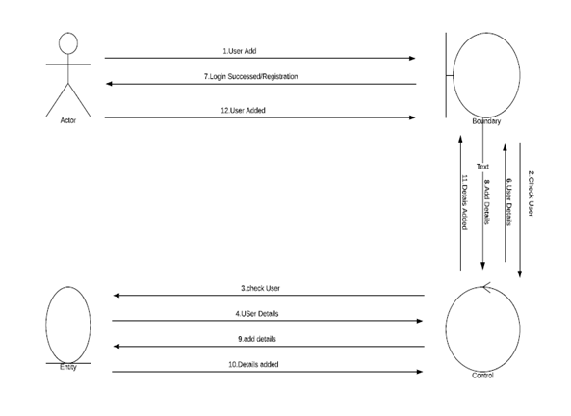
· COLLABORATION DIAGRAM FOR LOGIN

Slide 12
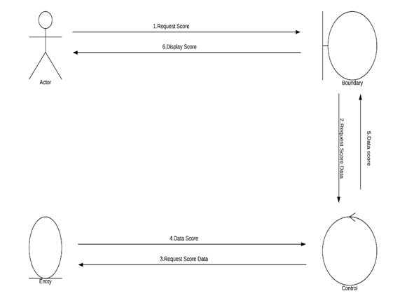
COLLABORATION DIAGRAM FOR USER SIDE SCOREBOARD

Slide 13
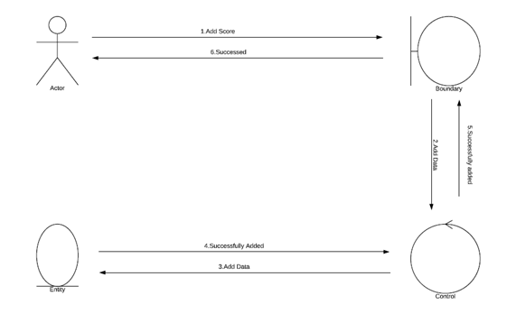
· COLLABORATION DIAGRAM FOR ADMIN SIDE SCOREBOARD

Slide 14
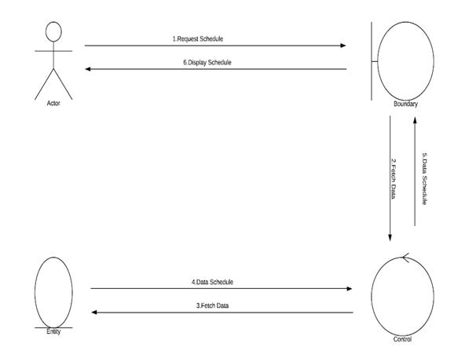
· COLLABORATION DIAGRAM FOR USER SIDE SCHEDULE

Slide 15
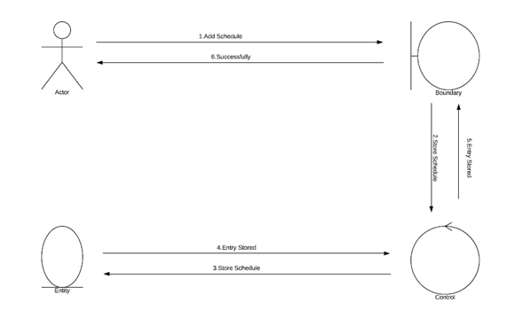
· COLLABORATION DIAGRAM FOR ADMIN SIDE SCHEDULE

Slide 16
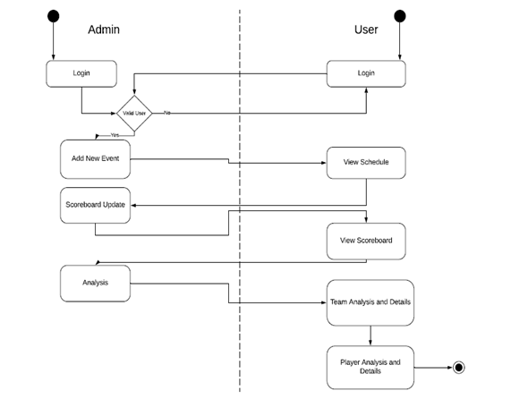
· ACTIVITY DIAGRAM FOR SCOREBOARD, SCHEDULE AND ANALYSIS

Slide 17
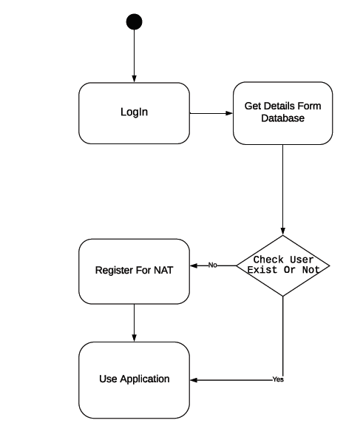
· STATE CHART DIAGRAM FOR LOGIN

Slide 18
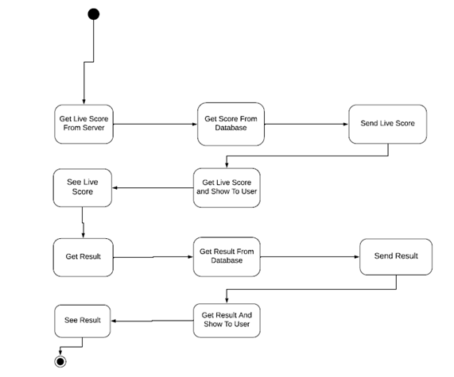
· STATE CHART DIAGRAM FOR LIVE SCORE

Slide 19
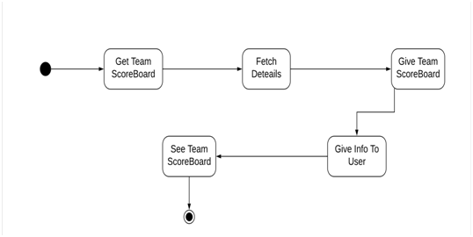
· STATE CHART DIAGRAM OF SCOREBOARD

Slide 20
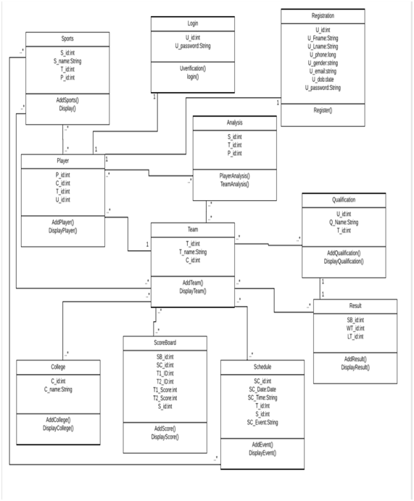
· CLASS DIAGRAM OF SCOREBOARD, SCHEDULE AND ANALYSIS

Slide 21

sportify
Logo of application and name

Slide 22
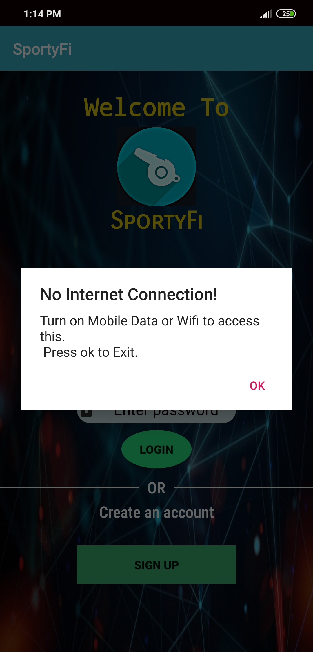
Application without internet connection
Application will show
dialog box if internet
connectivity is not
there.

Slide 23
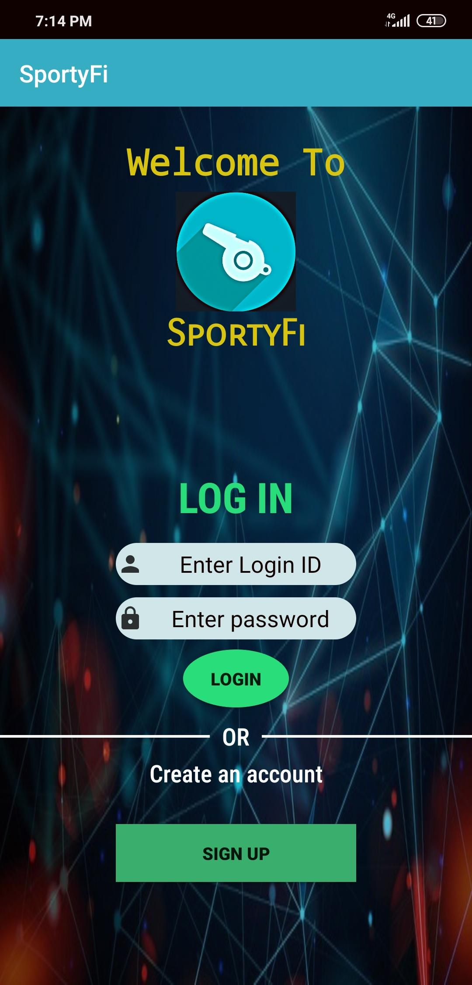
Login page
Registered admin and user can login.
New user can sign in and create their account.

Slide 24
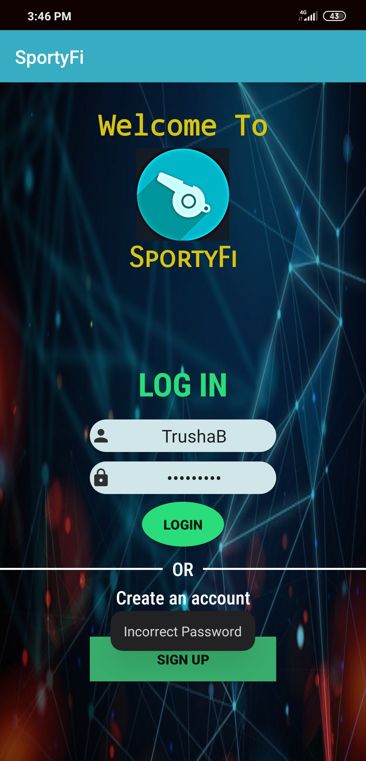
Login page
Login page has a validation if
user enters incorrect
password it will give and toast
of ‘incorrect password’.

Slide 25
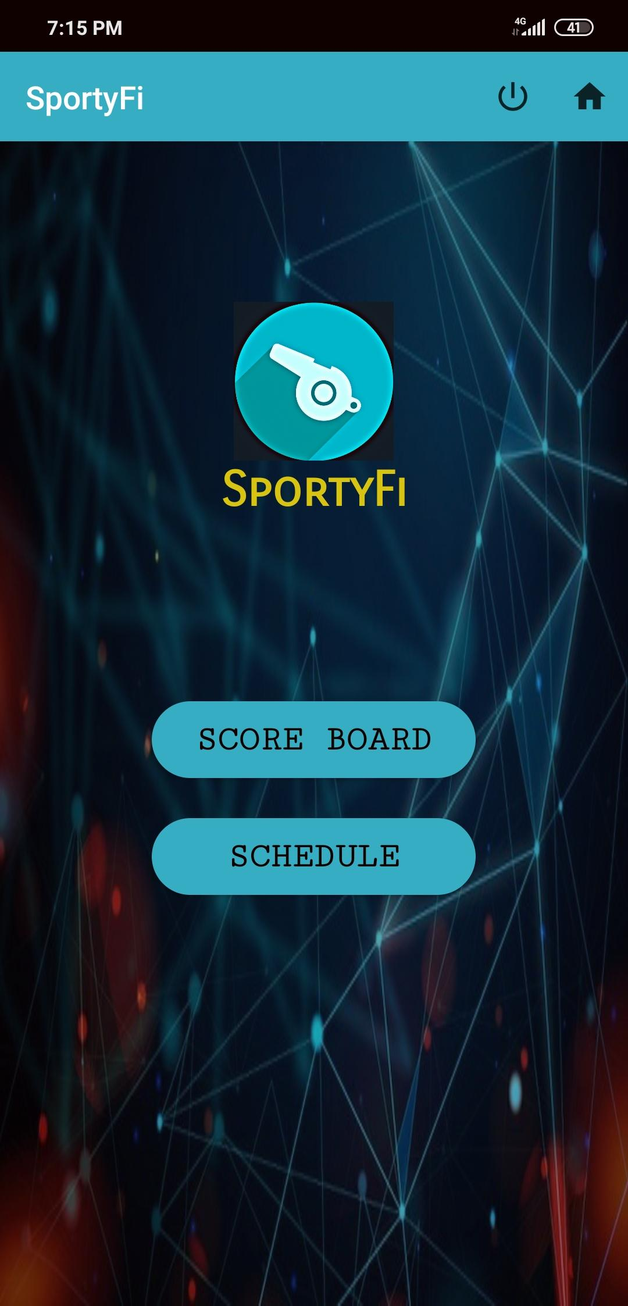
Admin side Home page
Admin side home page.

Slide 26
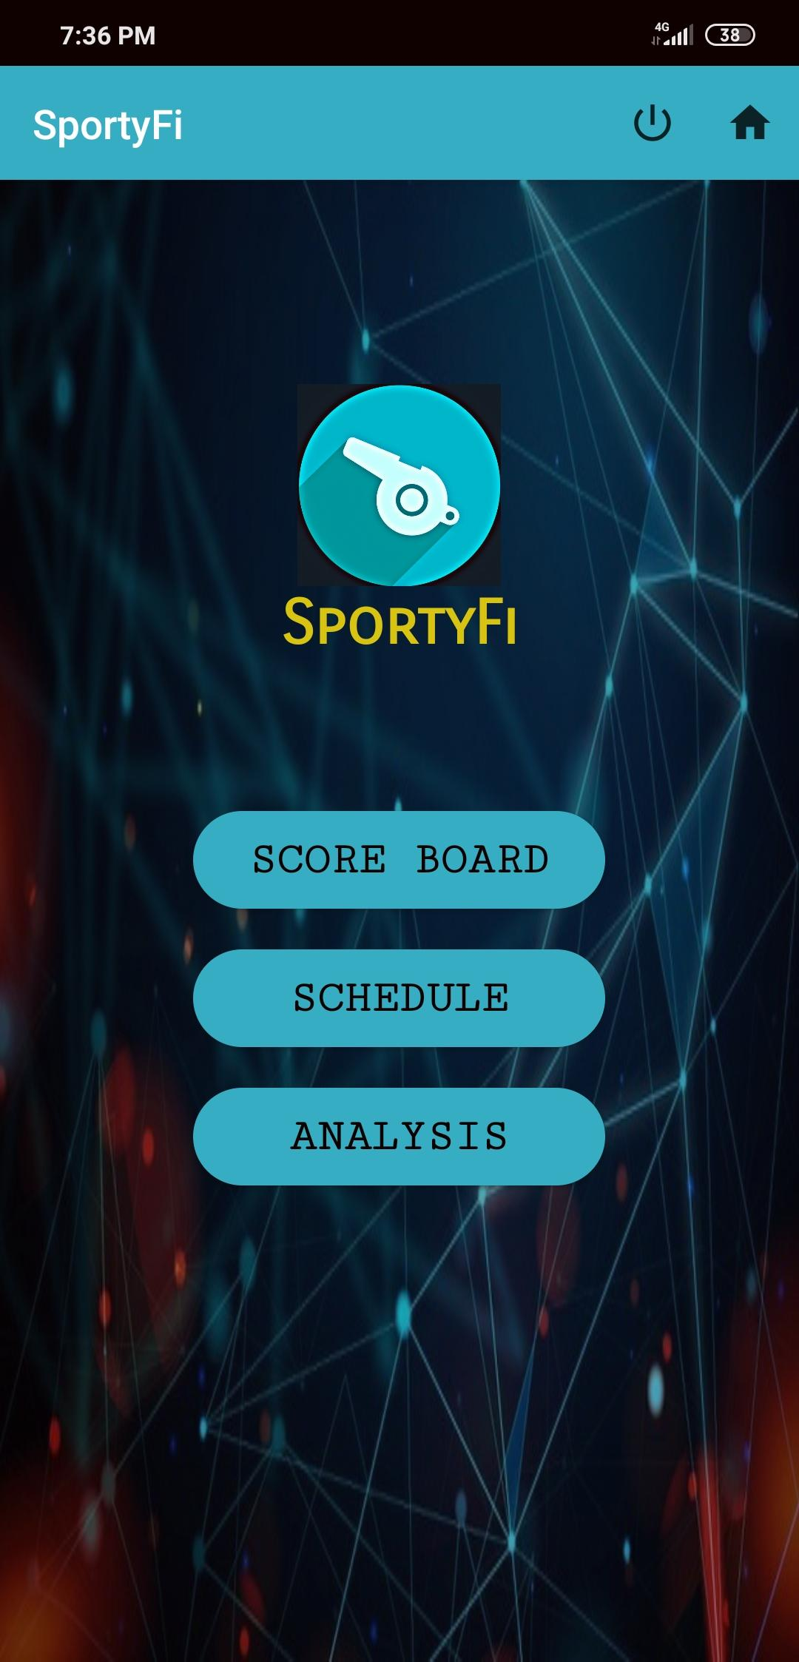
User side home page
User side home page.

Slide 27
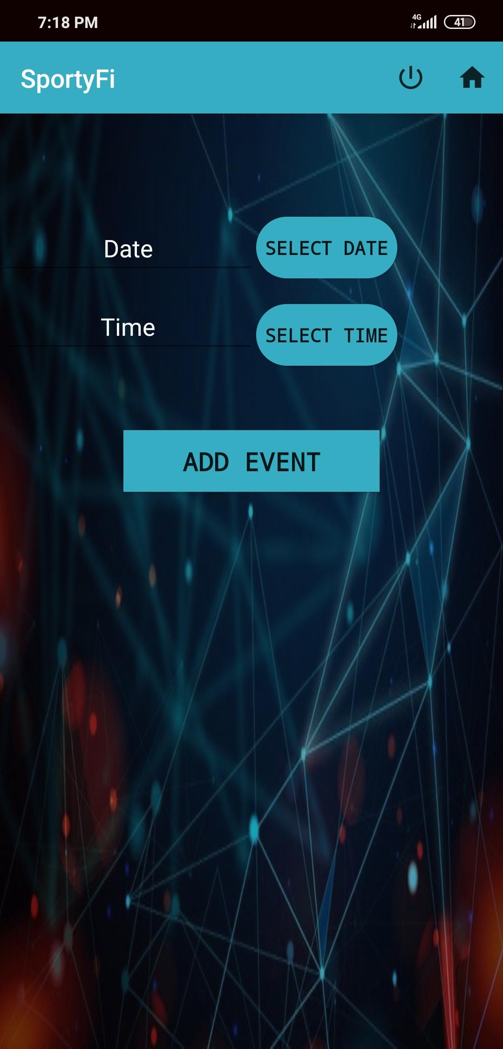
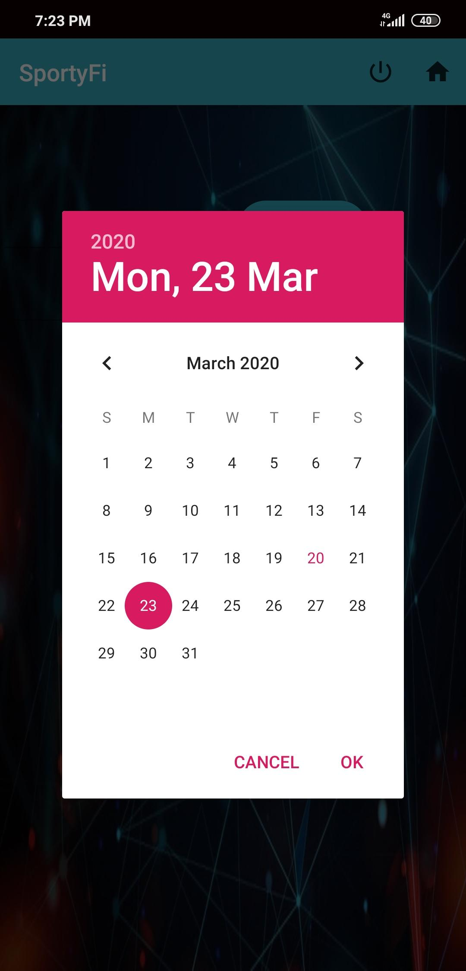
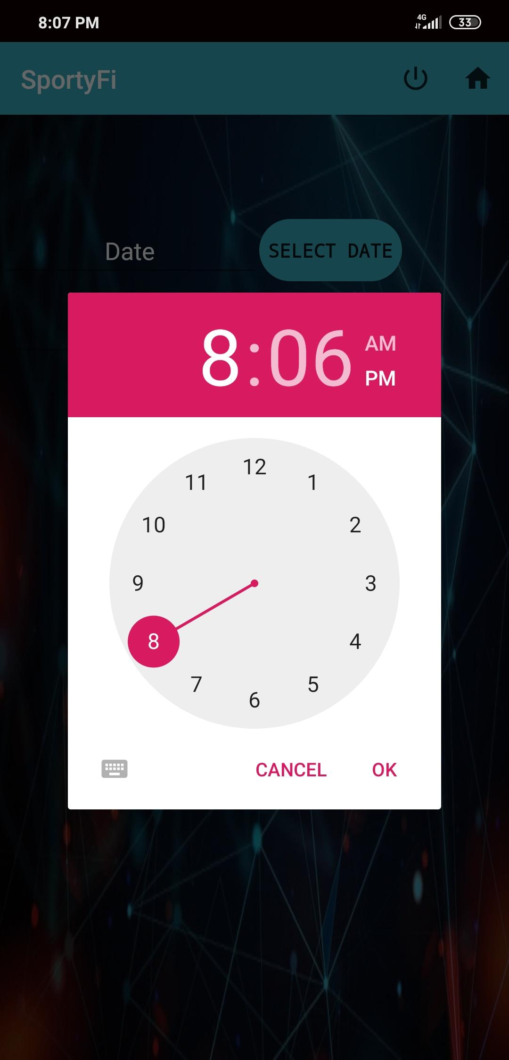
Admin side schedule
Schedule can be add by selecting dates using calendar.
And time using clock feature.

Slide 28
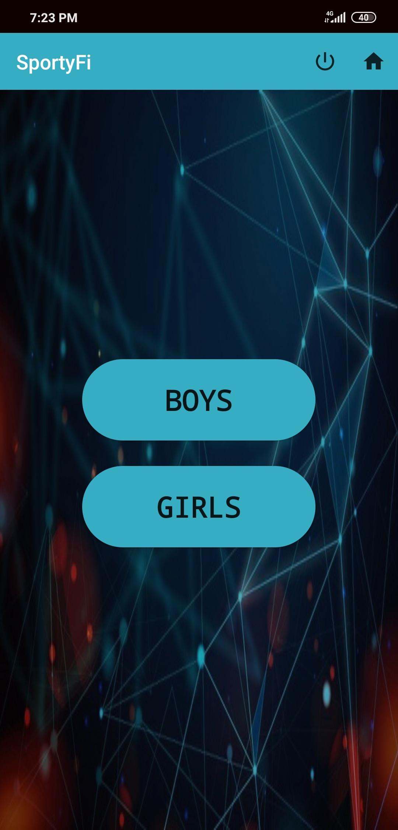
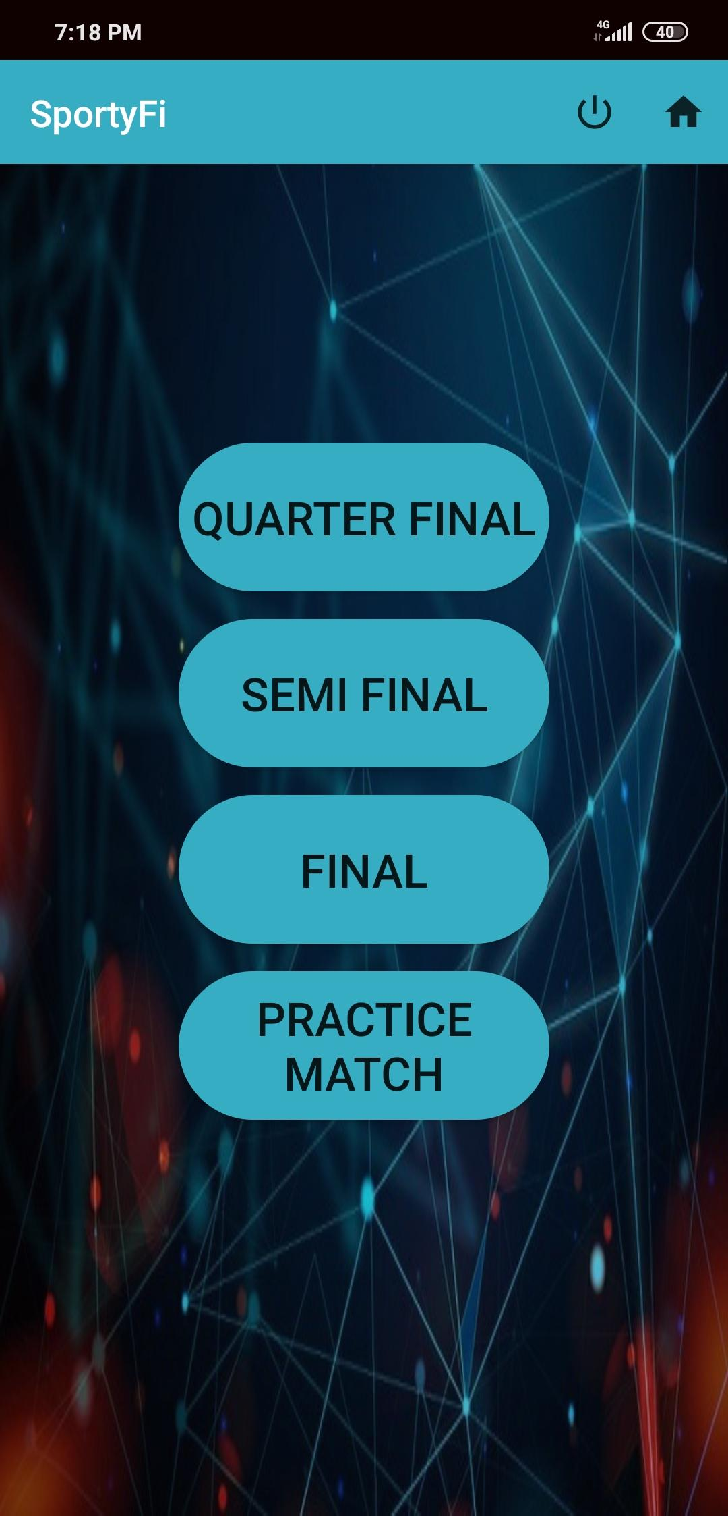
Admin side schedule
Further details admin needs to add are some specifications for choosing any sport.

Slide 29
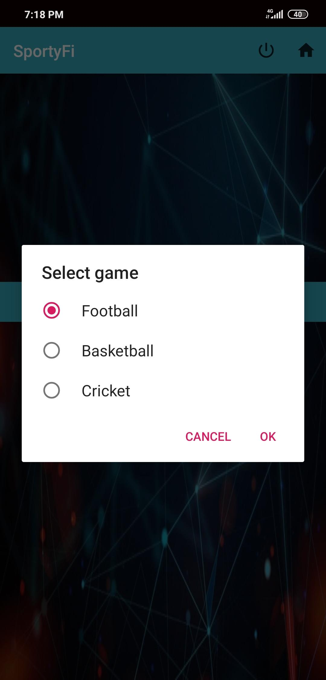
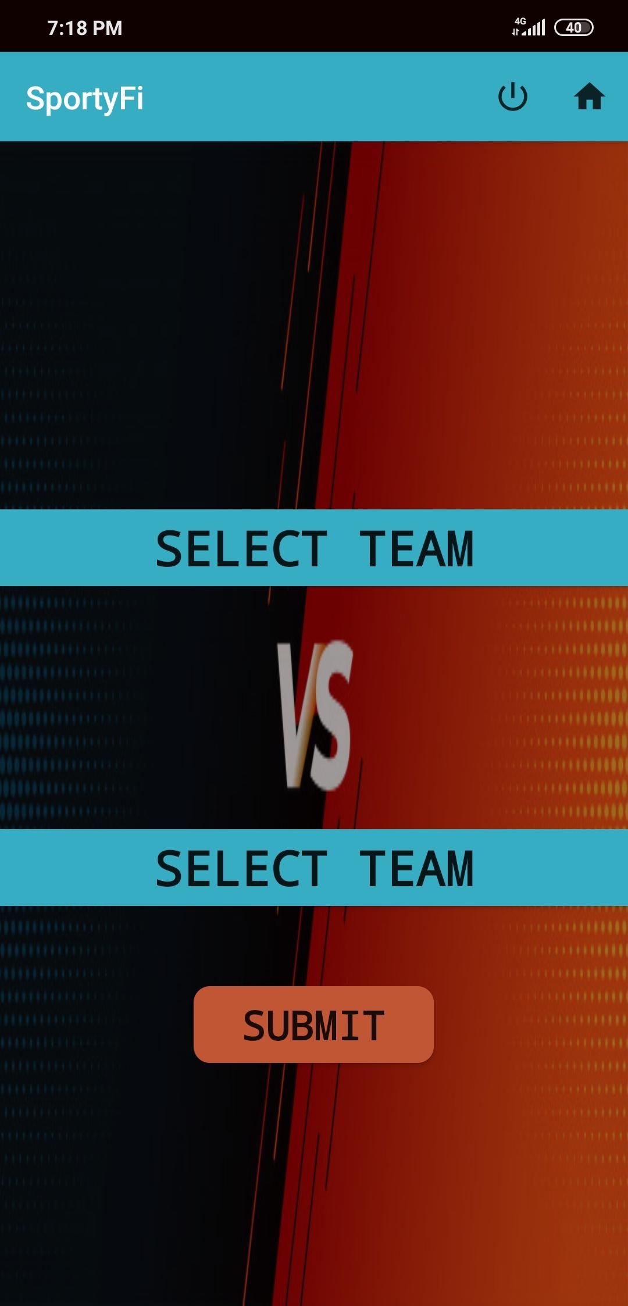
Admin side schedule
Here admin can select sport and select teams.

Slide 30
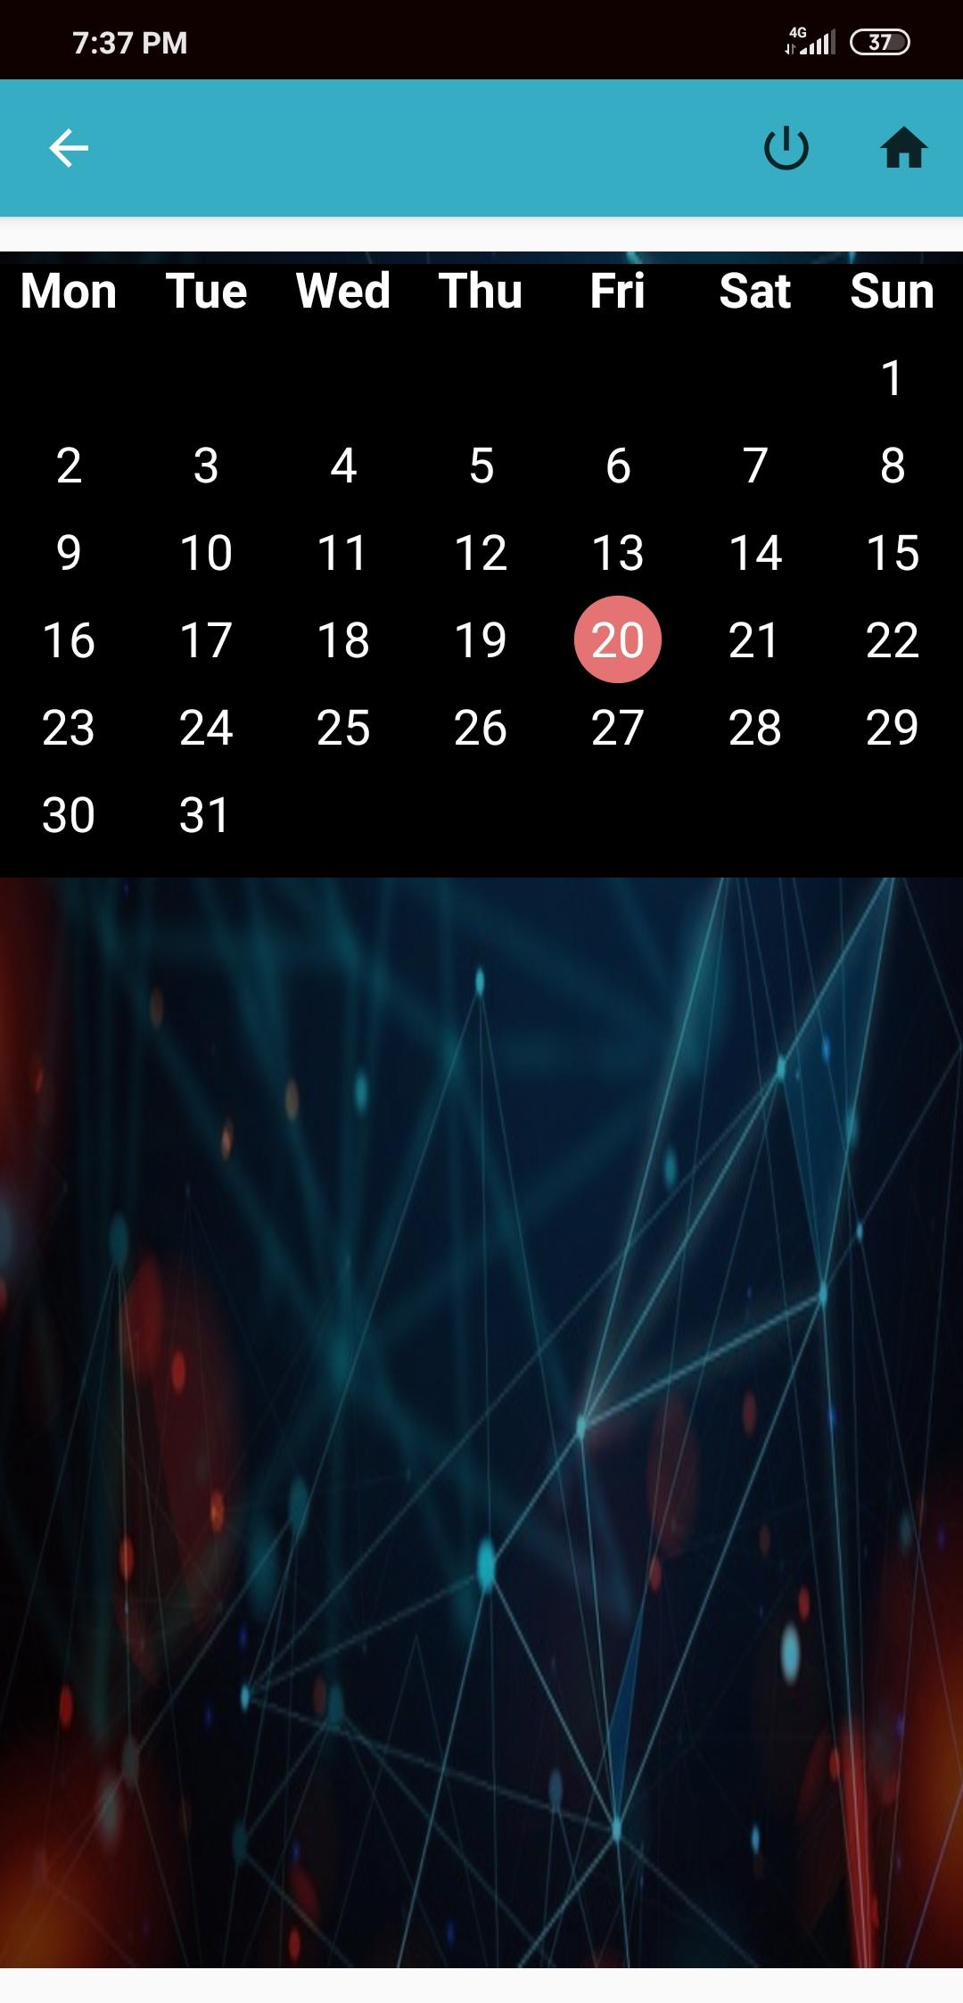
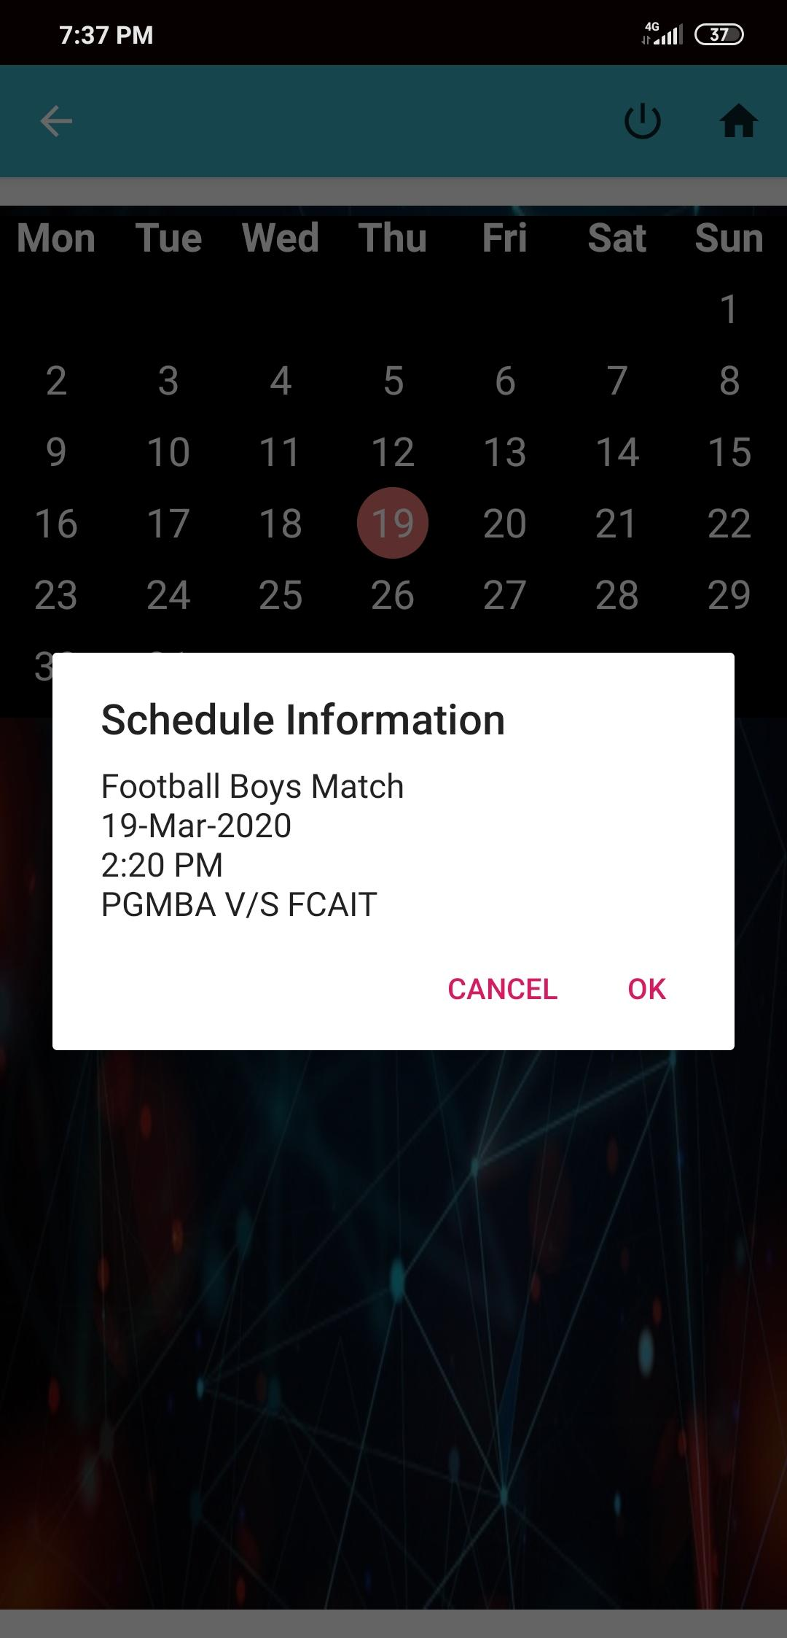
User side schedule
User can see the match details for some specific day and time.
If there will be no details it will display ‘No event plan for that day’.

Slide 31
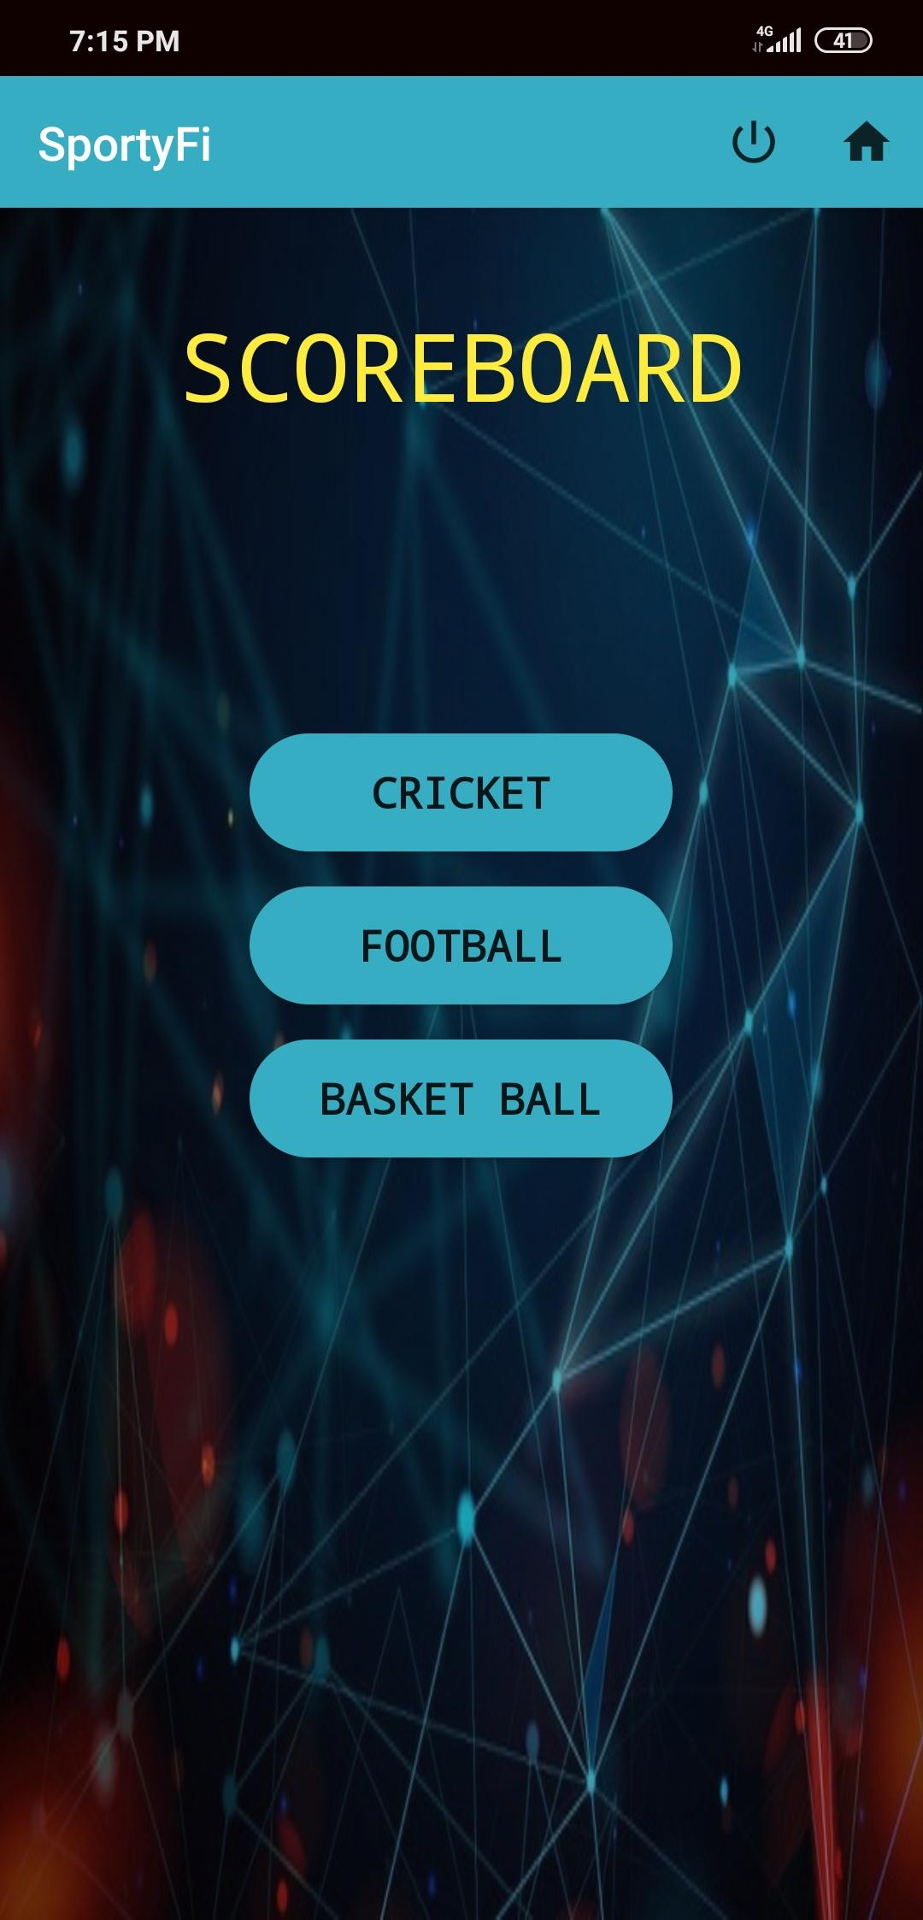
Admin side scoreboard
Admin will enter live scores using admin side scoreboard.
Admin can select for which sport he/she wants to enter score.

Slide 32
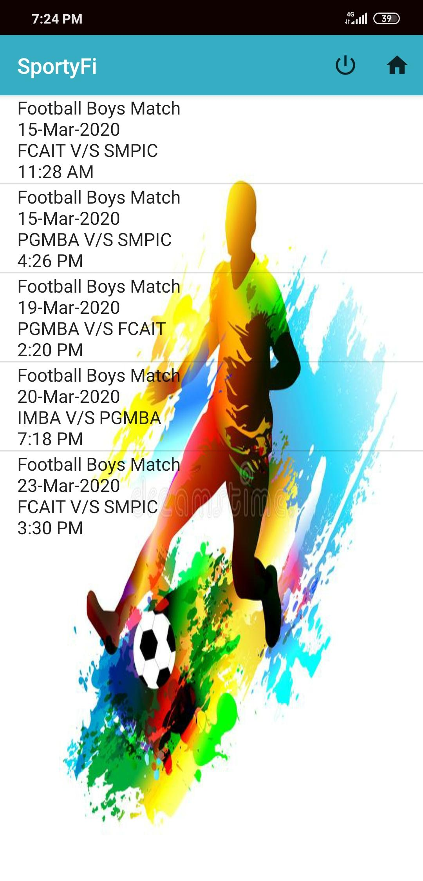
Admin side scoreboard-Football
Suppose we are here choosing football match it will display the list of football events that are already entered by admin using admin side schedule.

Slide 33
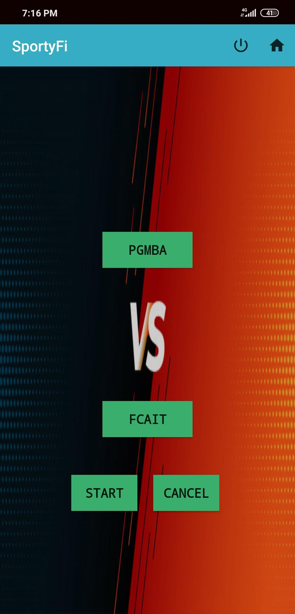
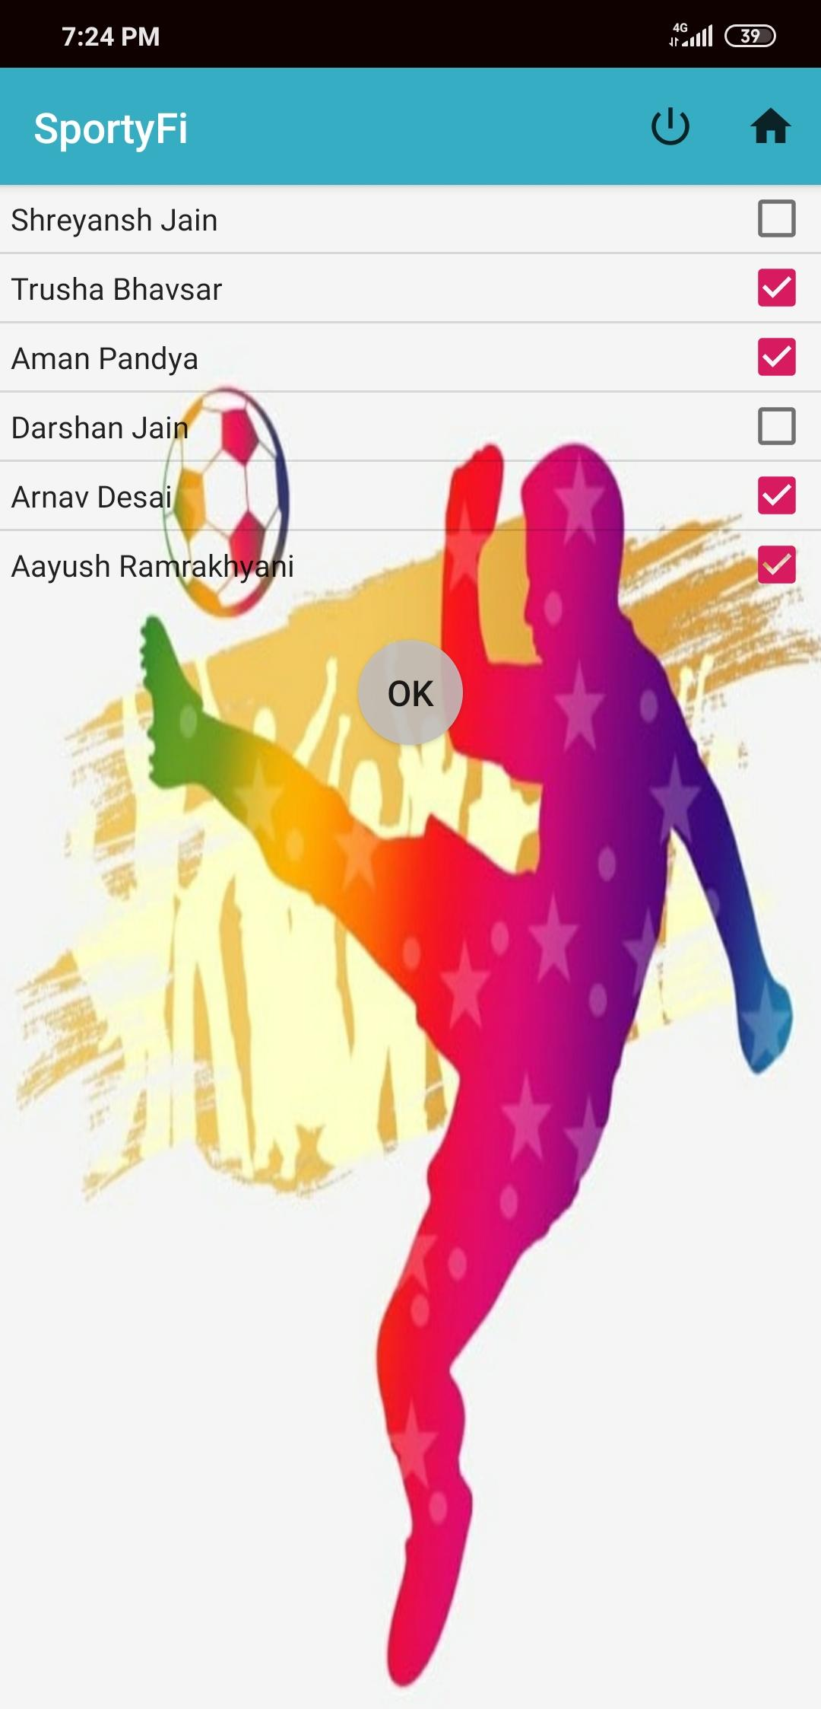
Admin side scoreboard-Football
As admin select event it will display the team names. Admin can choose players for particular team.

Slide 34
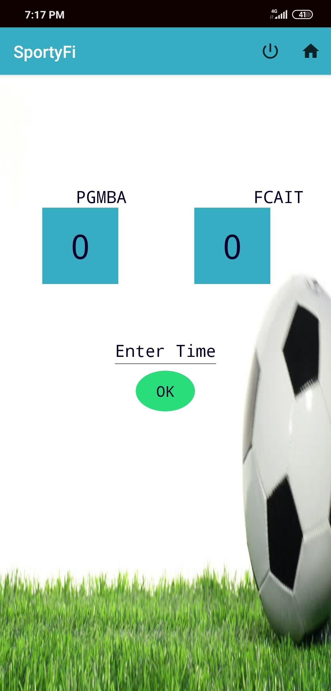
Admin side scoreboard-Football
This is the football scoreboard with timer to add time and score.

Slide 35
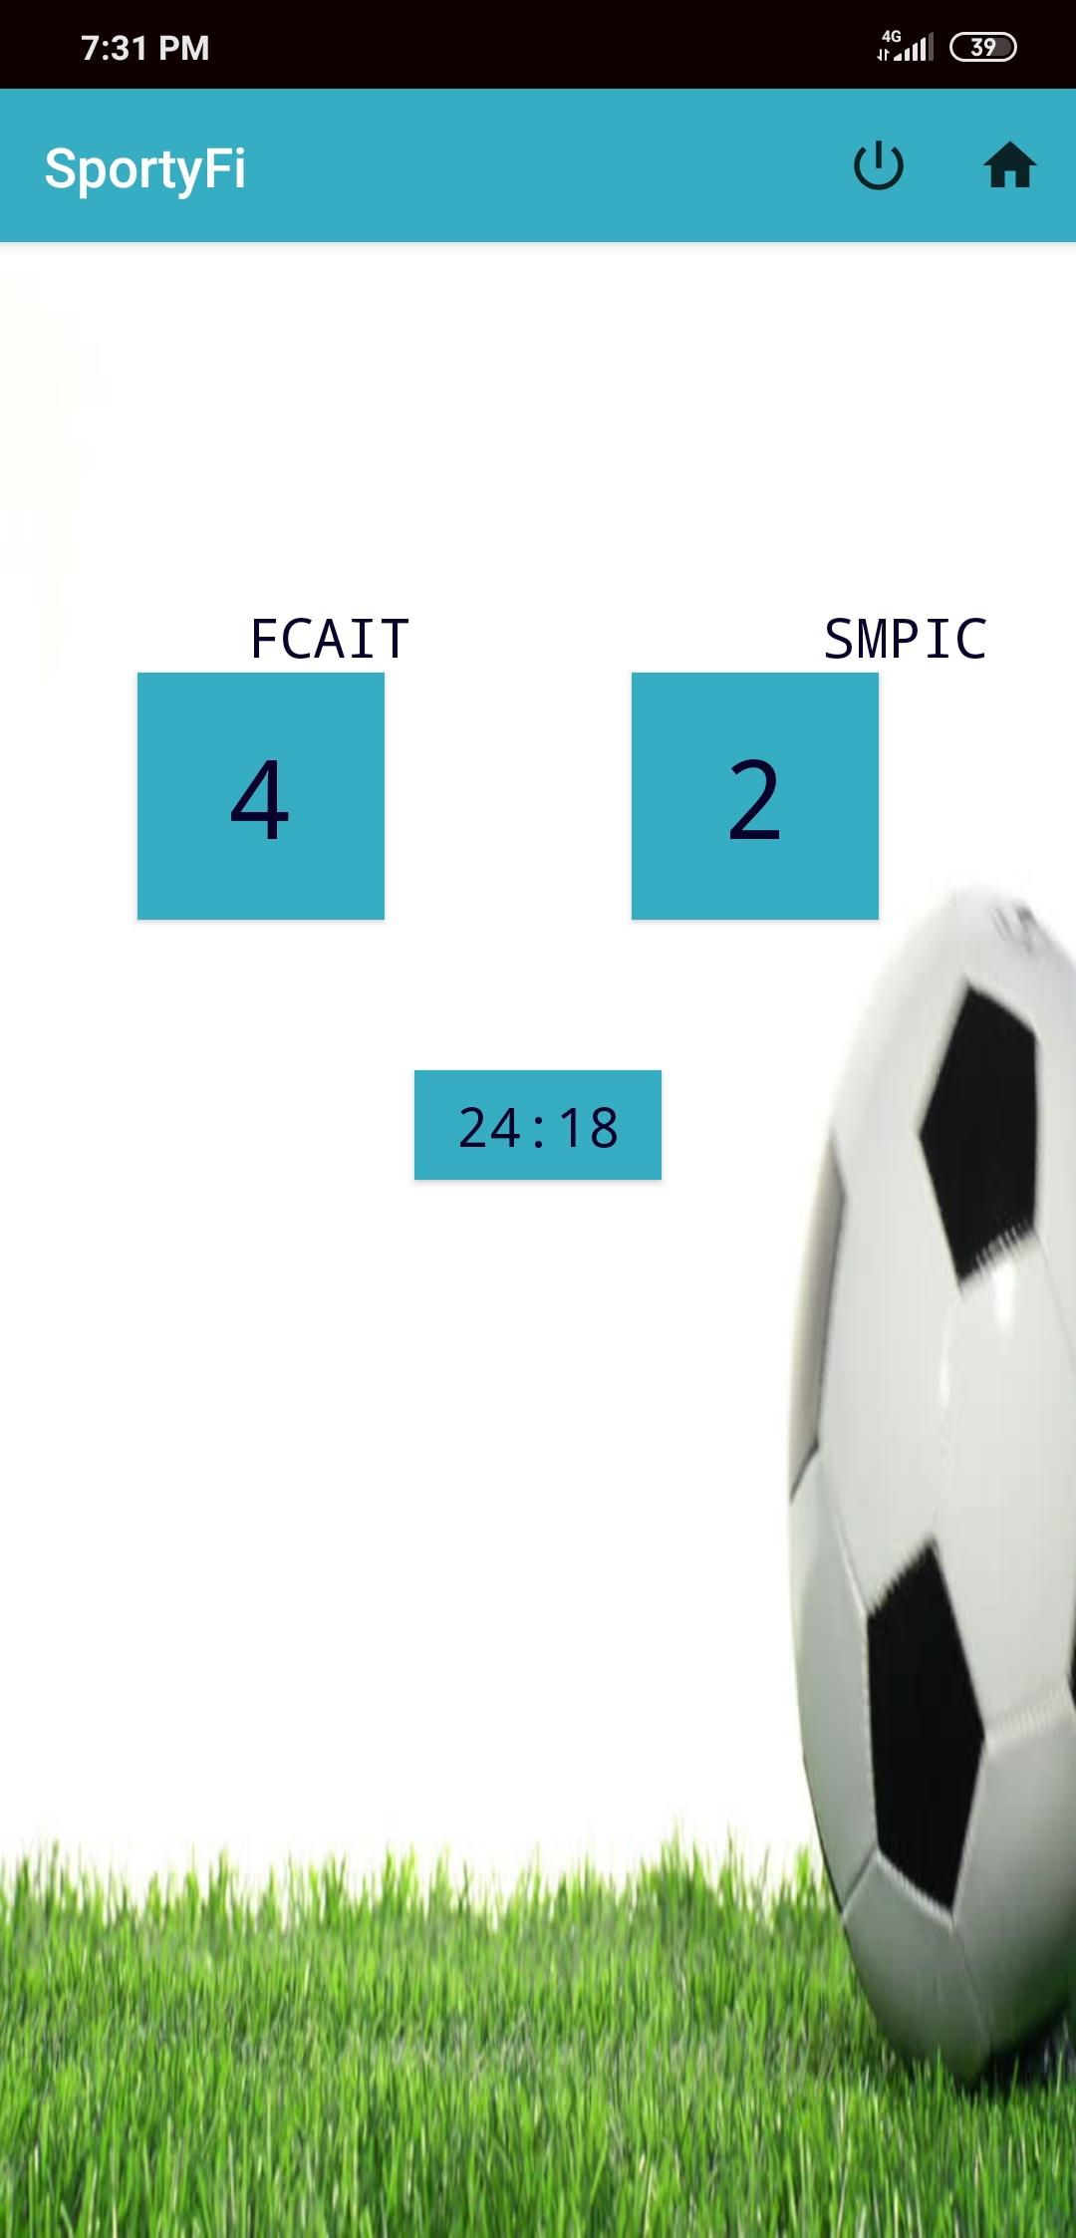
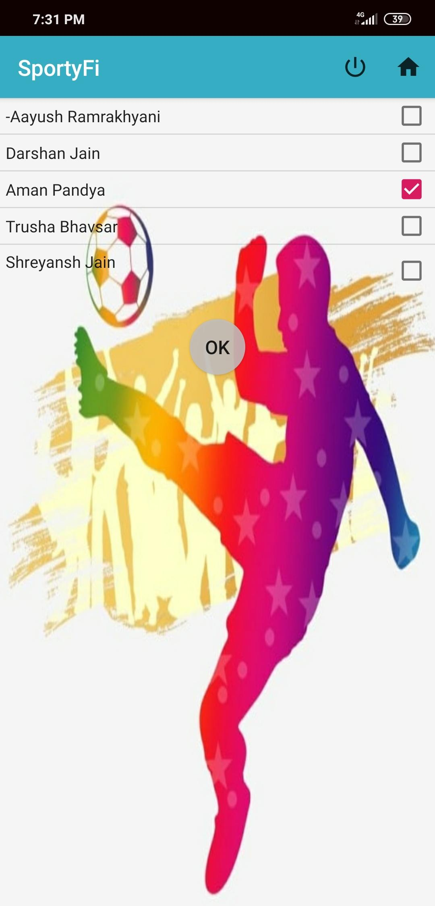
Admin side scoreboard-Football
-To add scores admin need start timer, without that admin will not be able to add scores.
-Admin can also select player who did goal/basket.

Slide 36
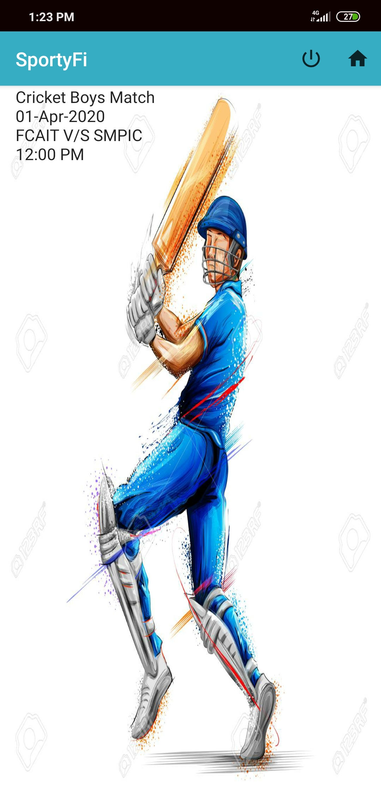

Admin side scoreboard-Cricket
Admin side cricket
scoreboard helps to add
the score of cricket.

Slide 37
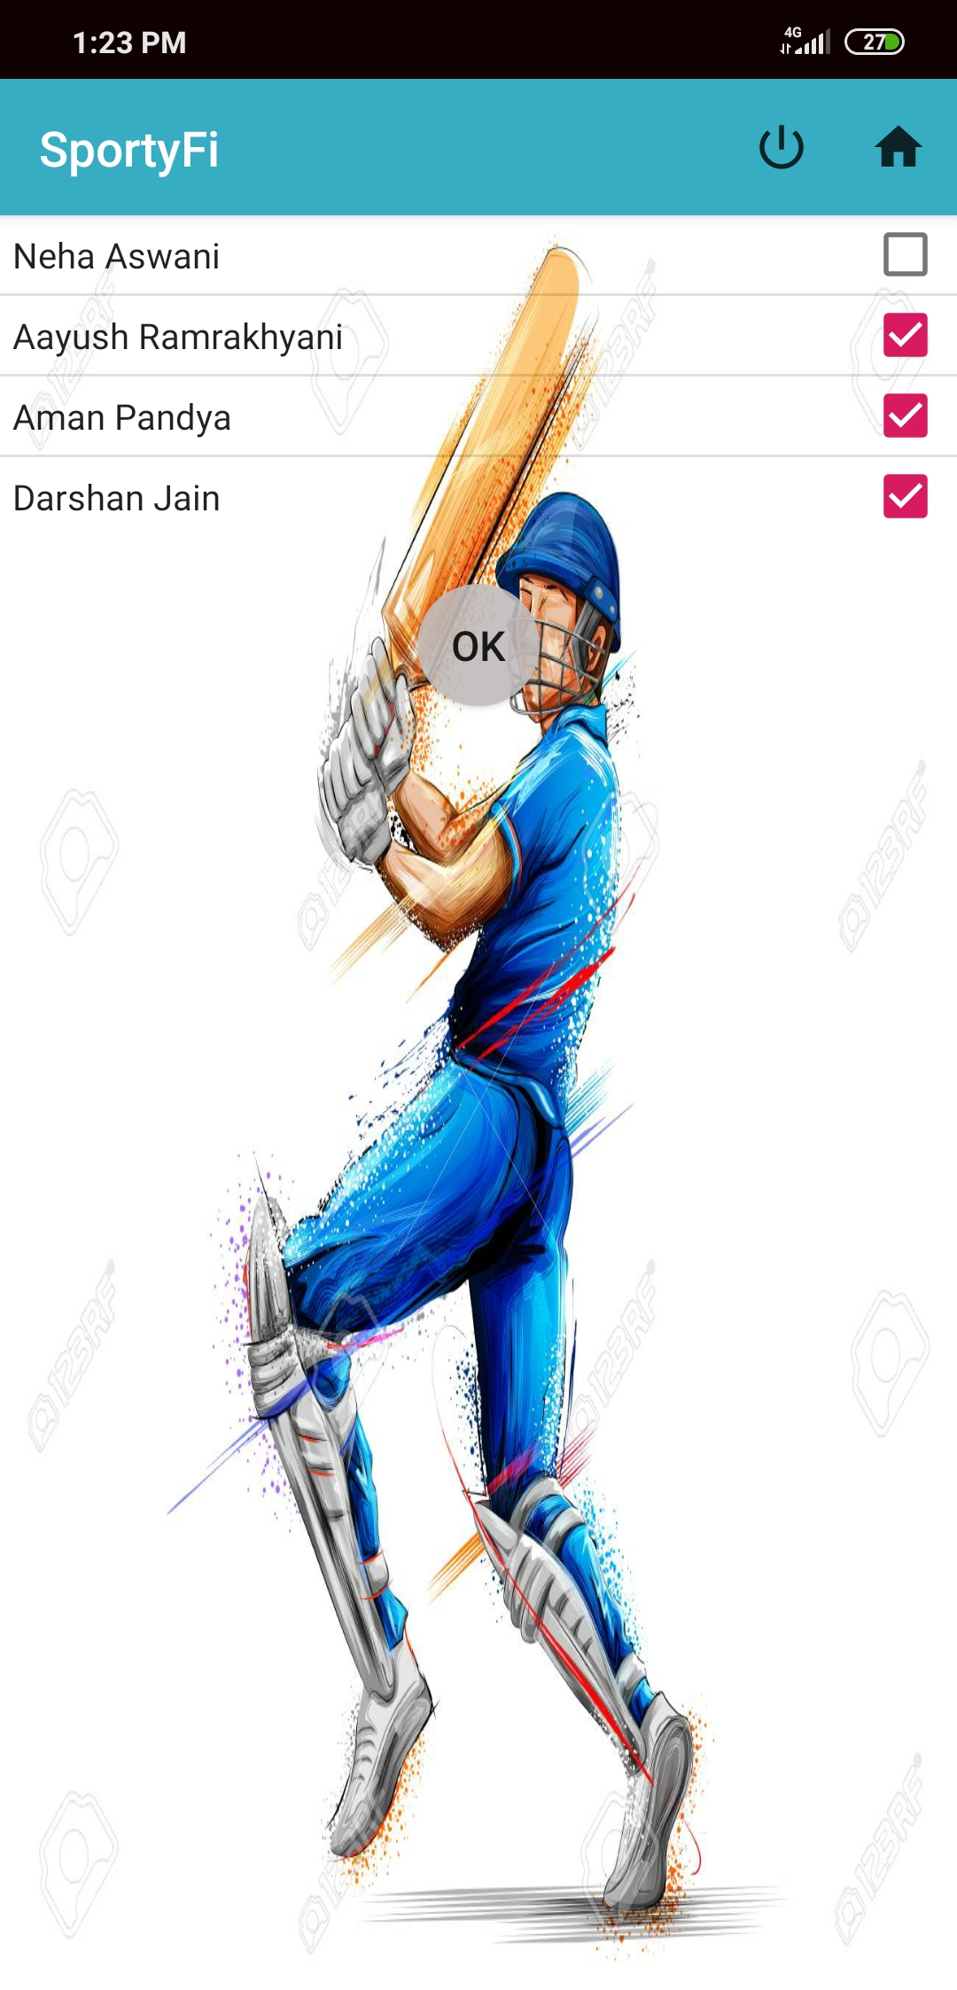
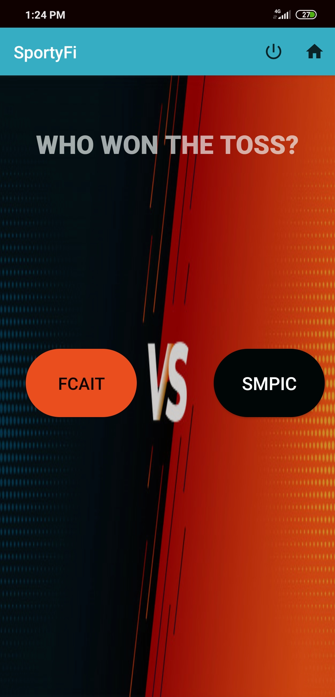
Admin side scoreboard-Cricket
Selecting the players
in cricket.
And choosing toss
winner.

Slide 38

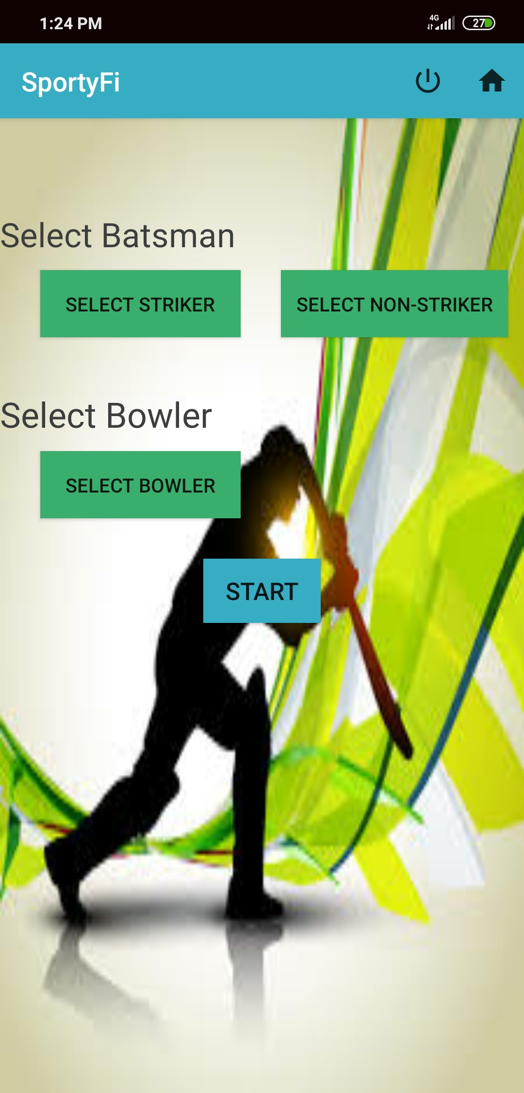
Admin side scoreboard-Cricket
Electing to bat or ball
and then selecting
players on striking ,
non-striking and
bowling position.

Slide 39
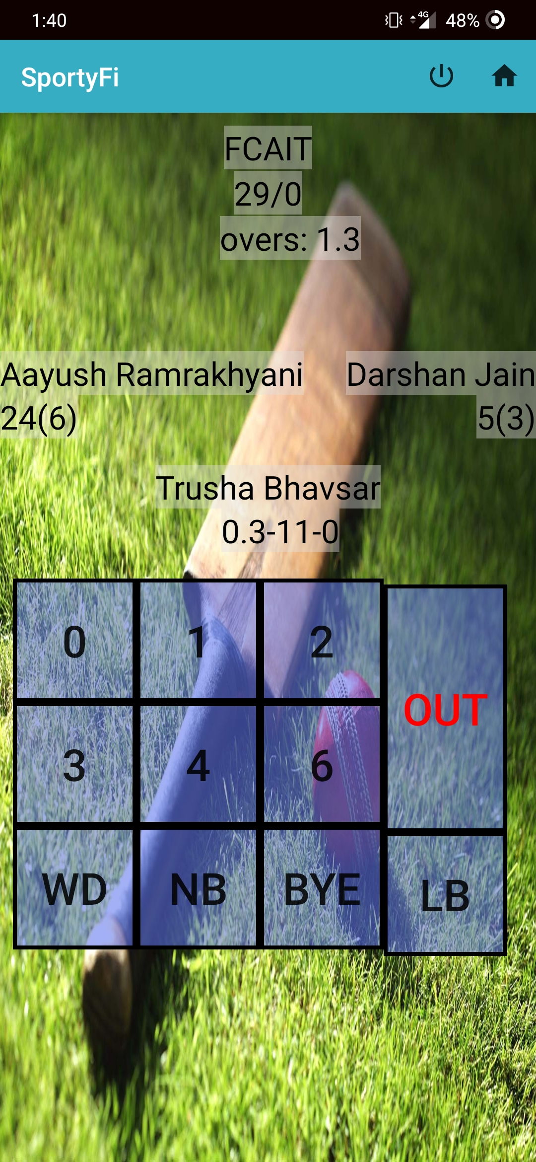
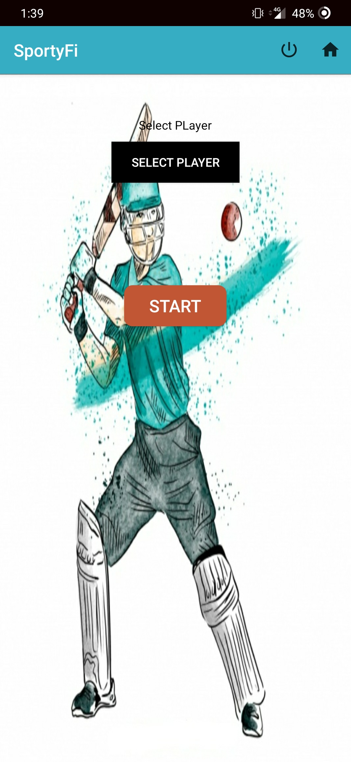
Admin side scoreboard-Cricket
Scoreboard of cricket
showing player’s names.
After completing an
over or after
wicket admin will get
An option to choose new
Bowler/Batsman.

Slide 40
User side scoreboard
User side scoreboard will show live scores to users.

Slide 41
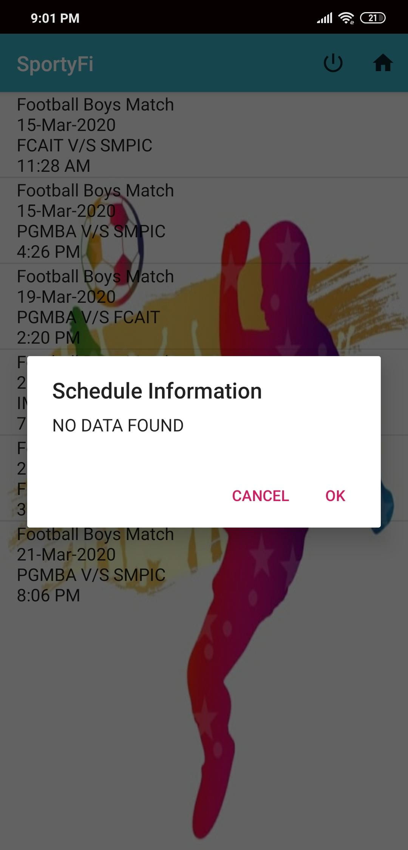
User side scoreboard-Football
By choosing the sport user can see the list of occurring events with details.
As user select choose event if there is no event, it will display no data found, else it will fetch data on real time basis.

Slide 42
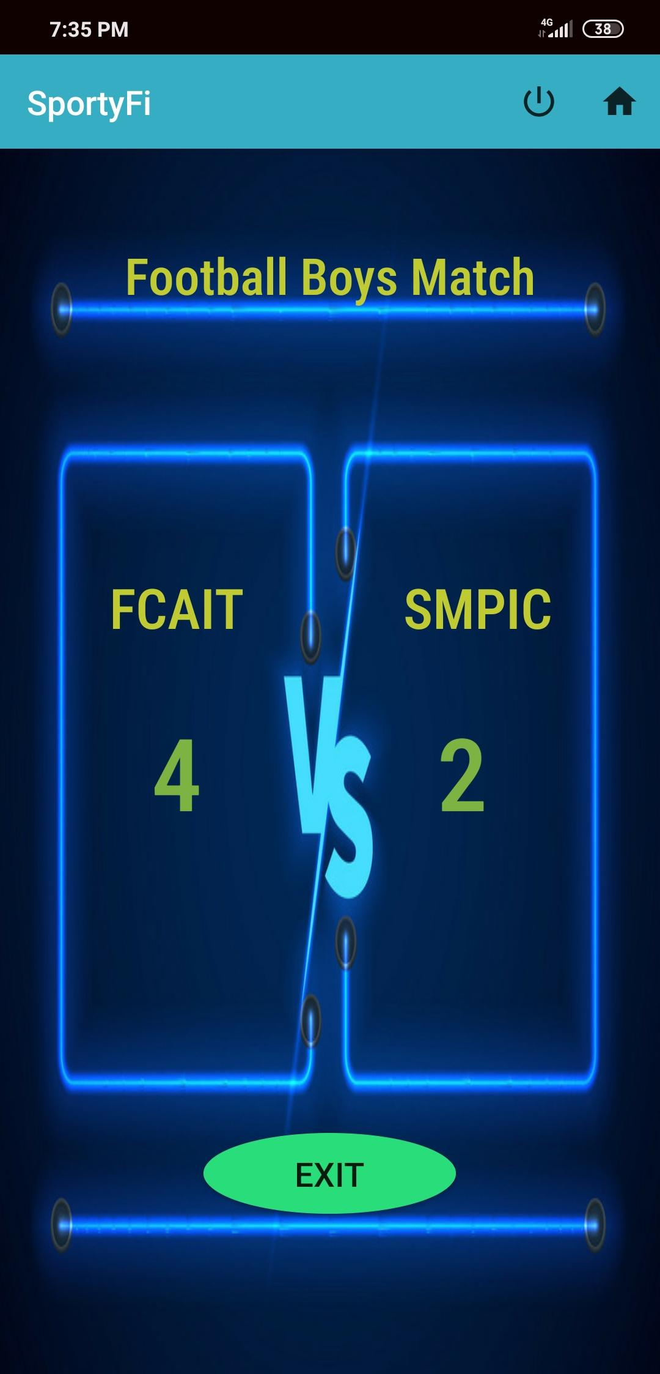
User side scoreboard-Football
User side scoreboard showing live scores for football.

Slide 43

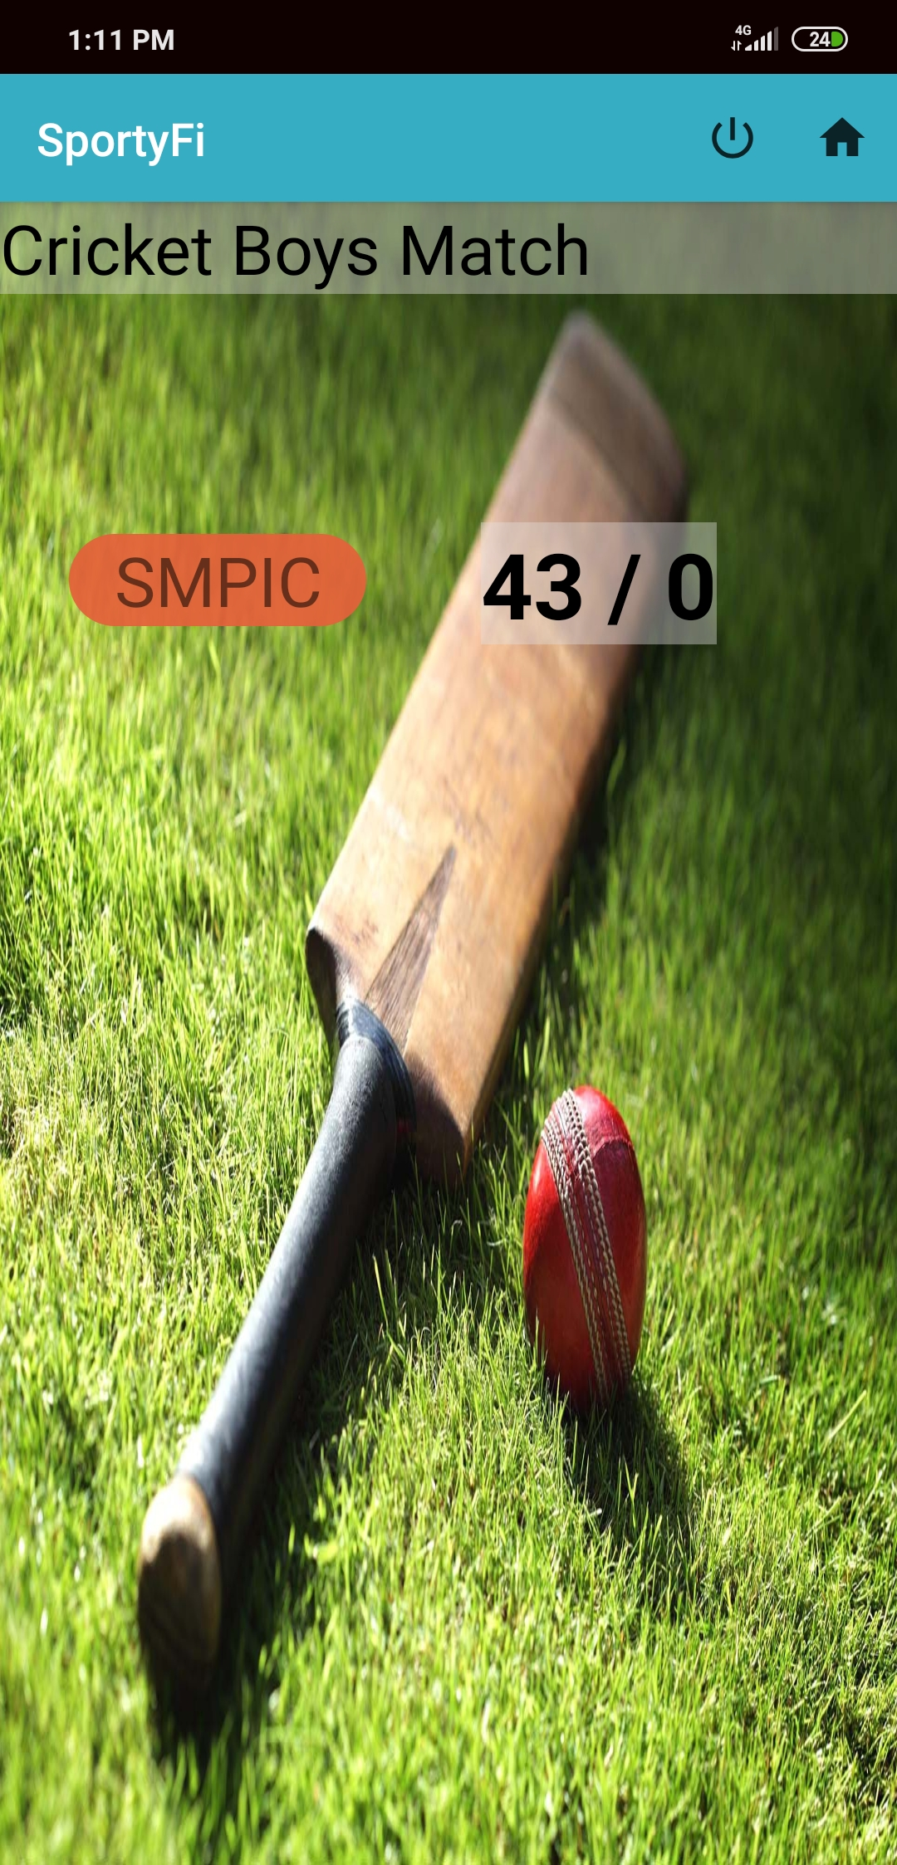
User side scoreboard-Cricket
User side scoreboard showing live scores for cricket.

Slide 44
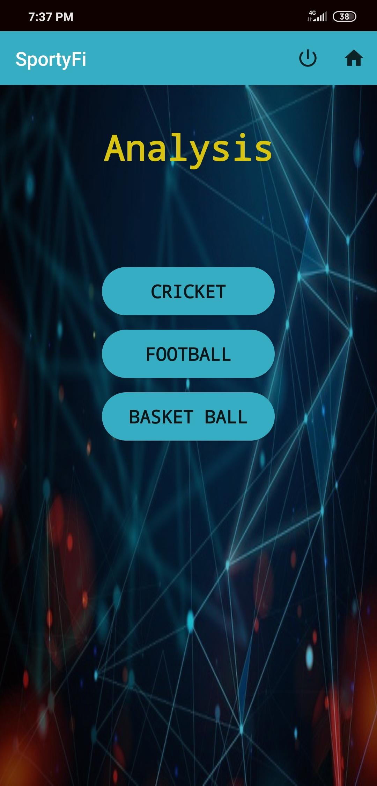
Analysis
User can see the analysis for particular sport as team and player analysis.

Slide 45
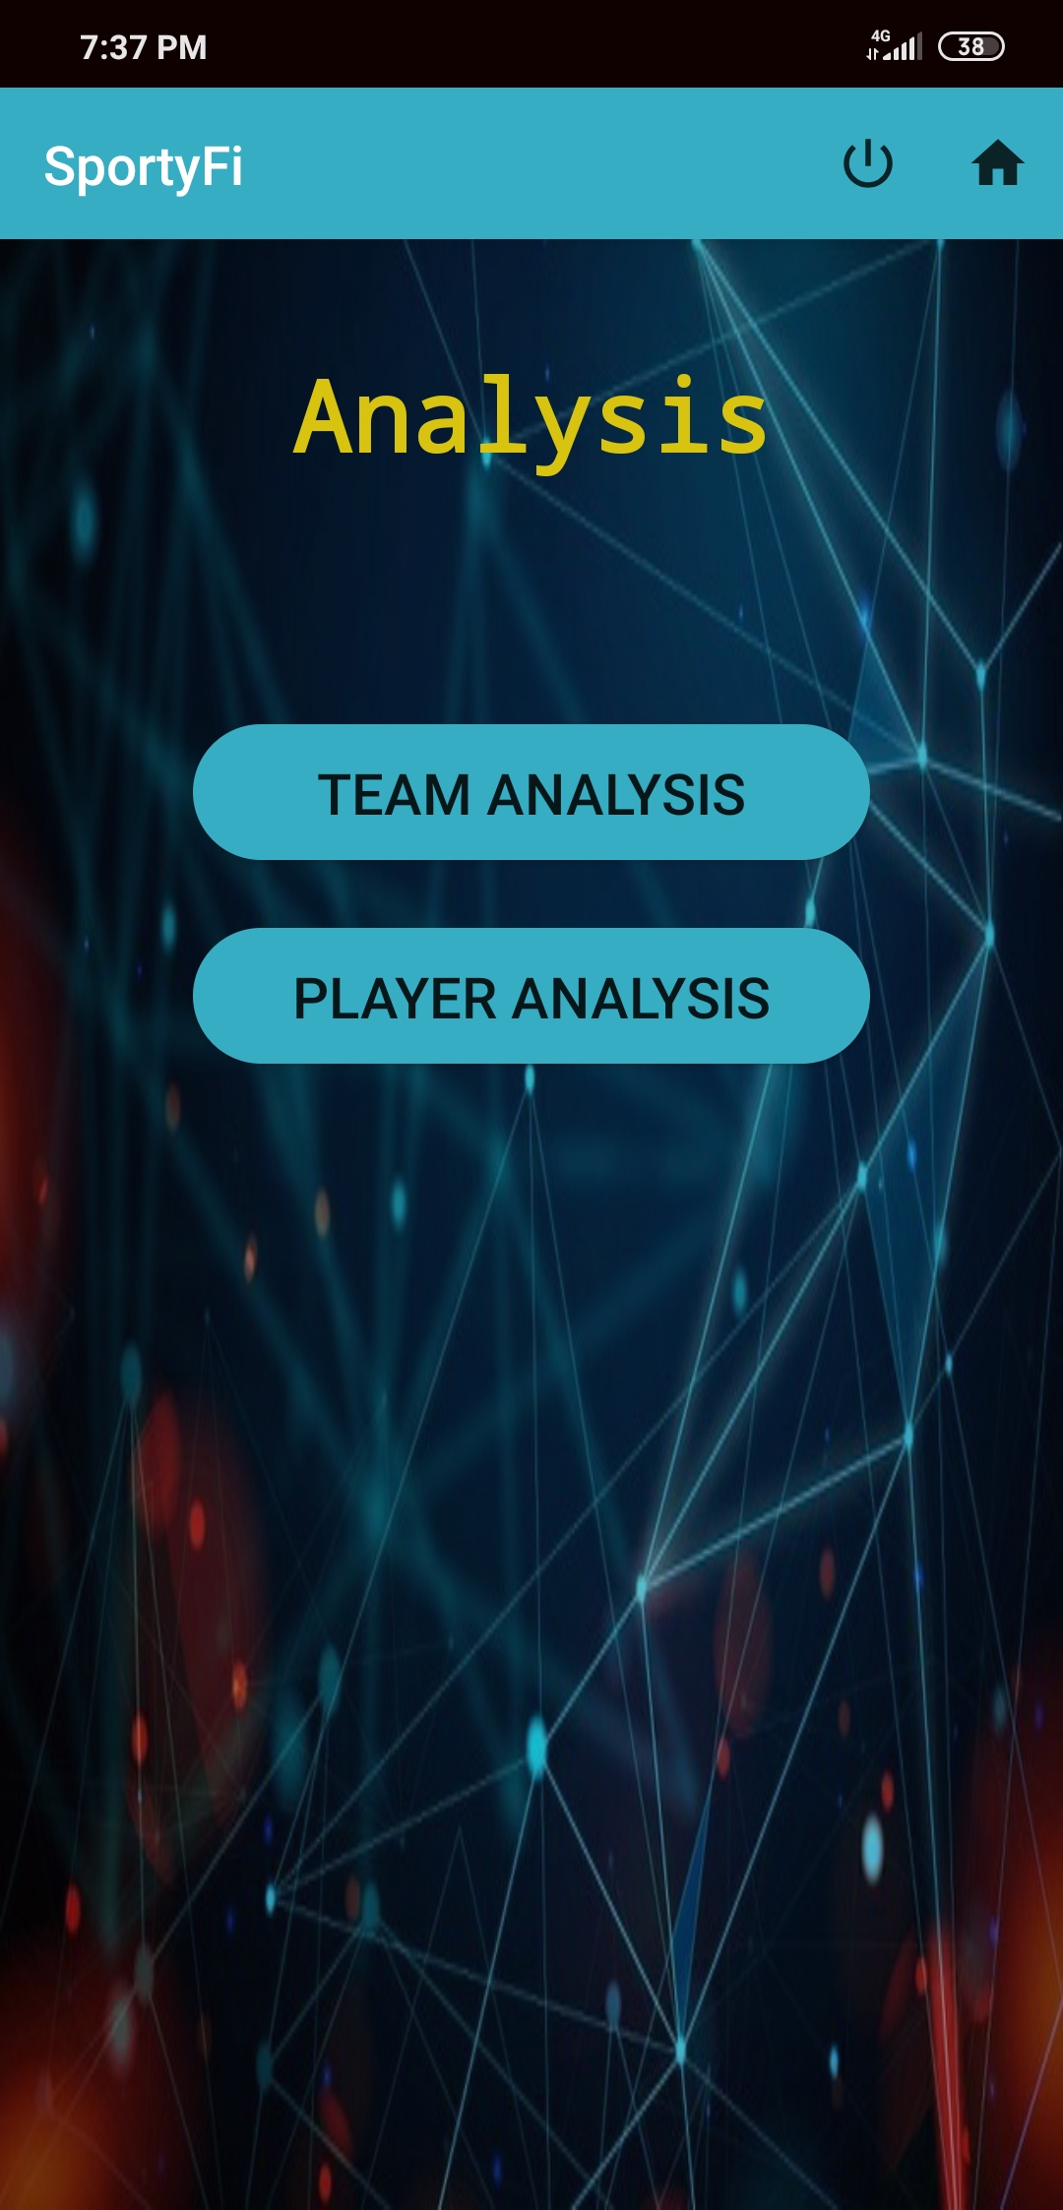
Analysis of football
Displaying team analysis.
As per which team has won most matches and which team has made most goals.
Displaying player analysis.
As per which player has made most goals.

Slide 46
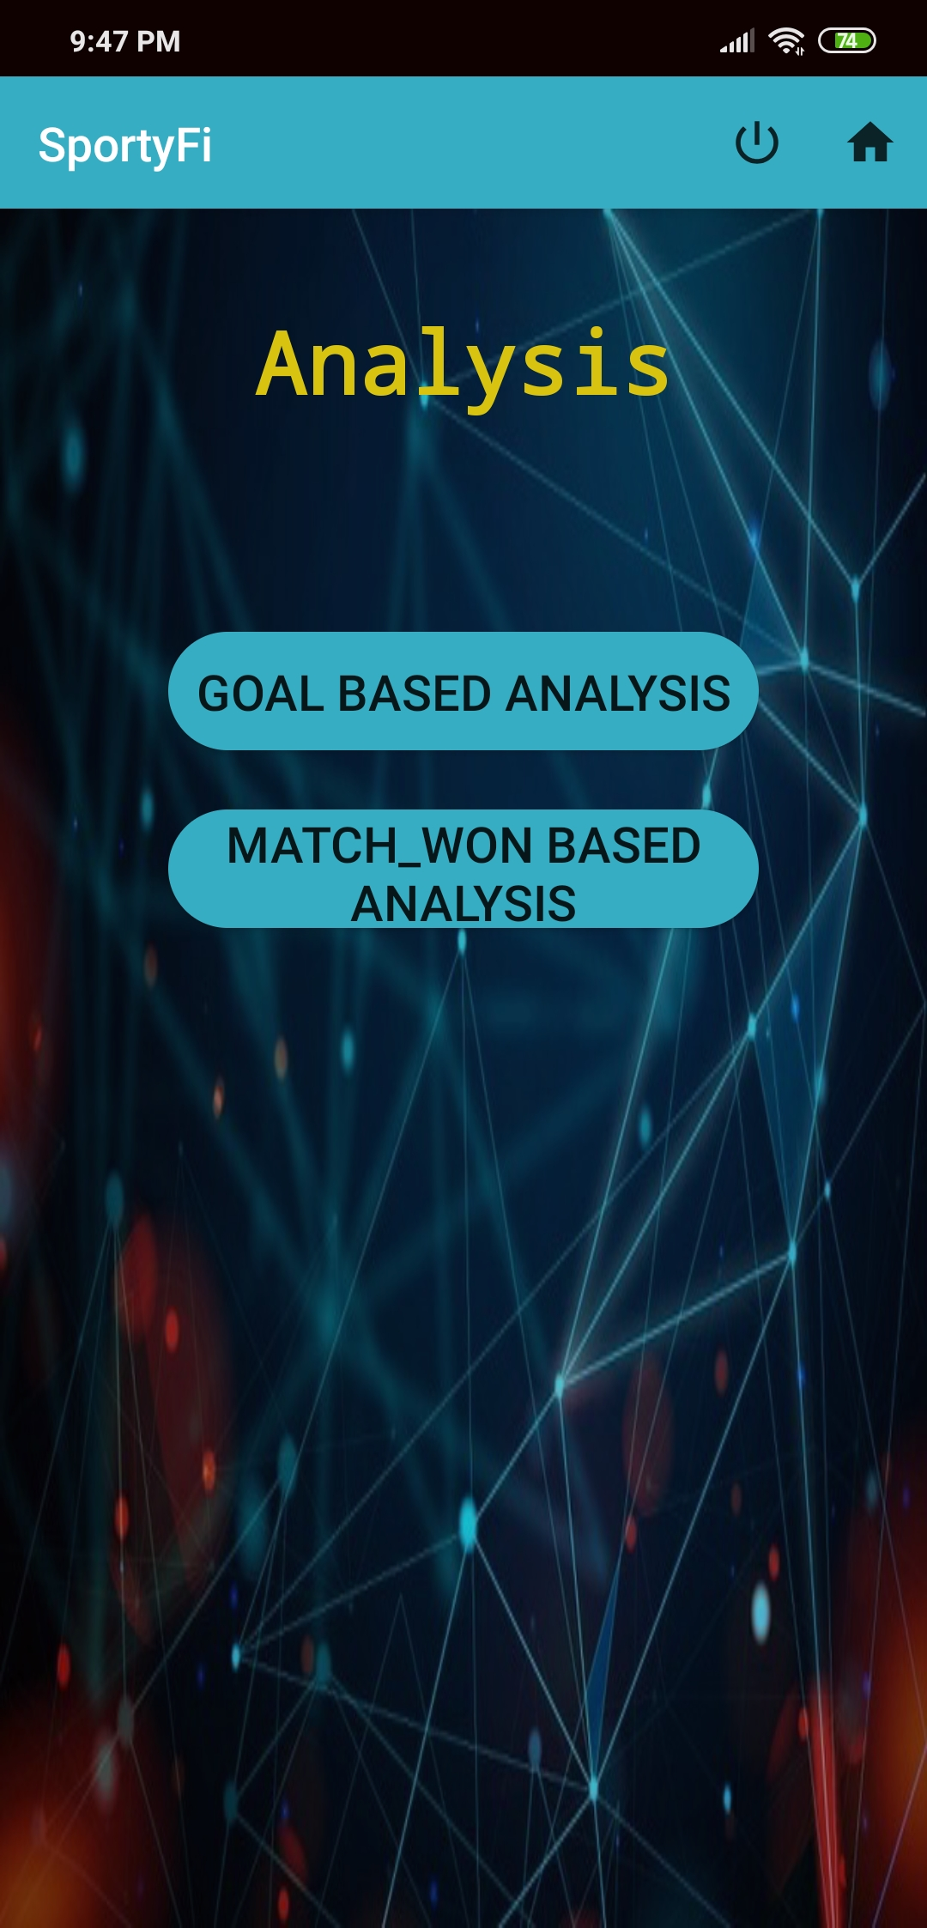
Analysis of football
Team analysis
Goal based analysis is based on which team made most goals.
Match won based analysis is based on which team won most matches.

Slide 47
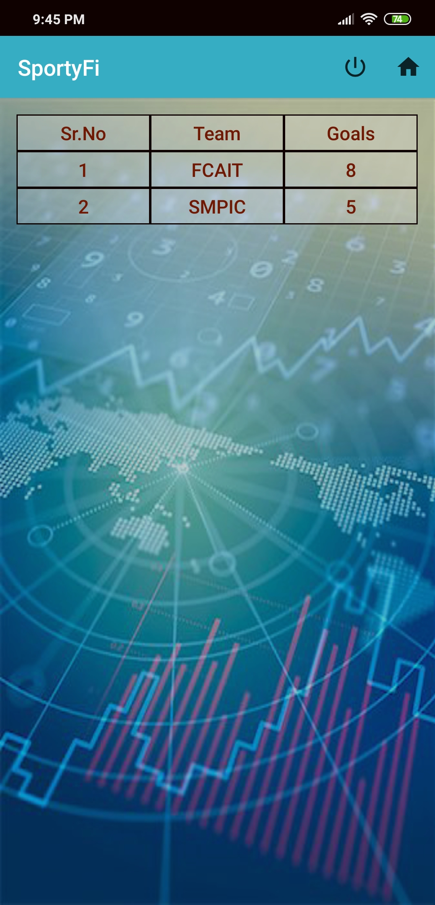

Analysis of football
Team analysis
1.Analysis based on goals.
2.Analysis based on match won.

Slide 48
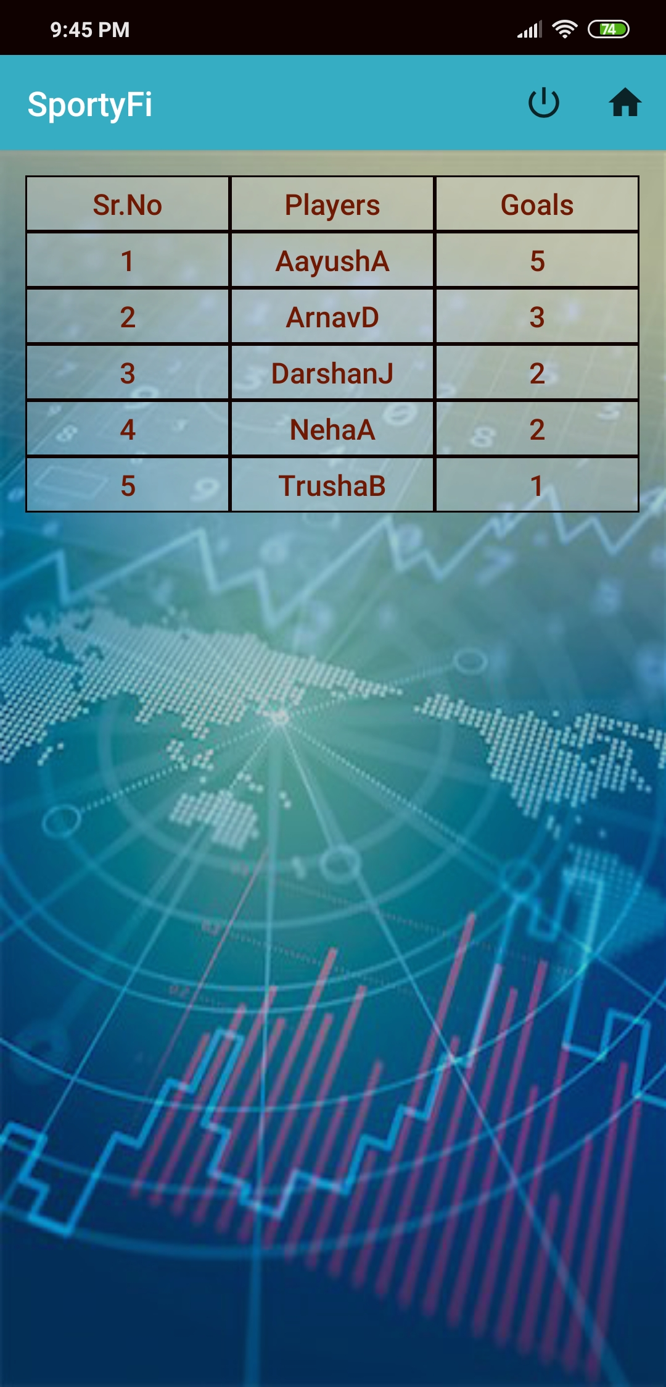
Analysis of football
Player analysis
Player analysis of
football game is only
based on which player
made most goals.

Slide 49
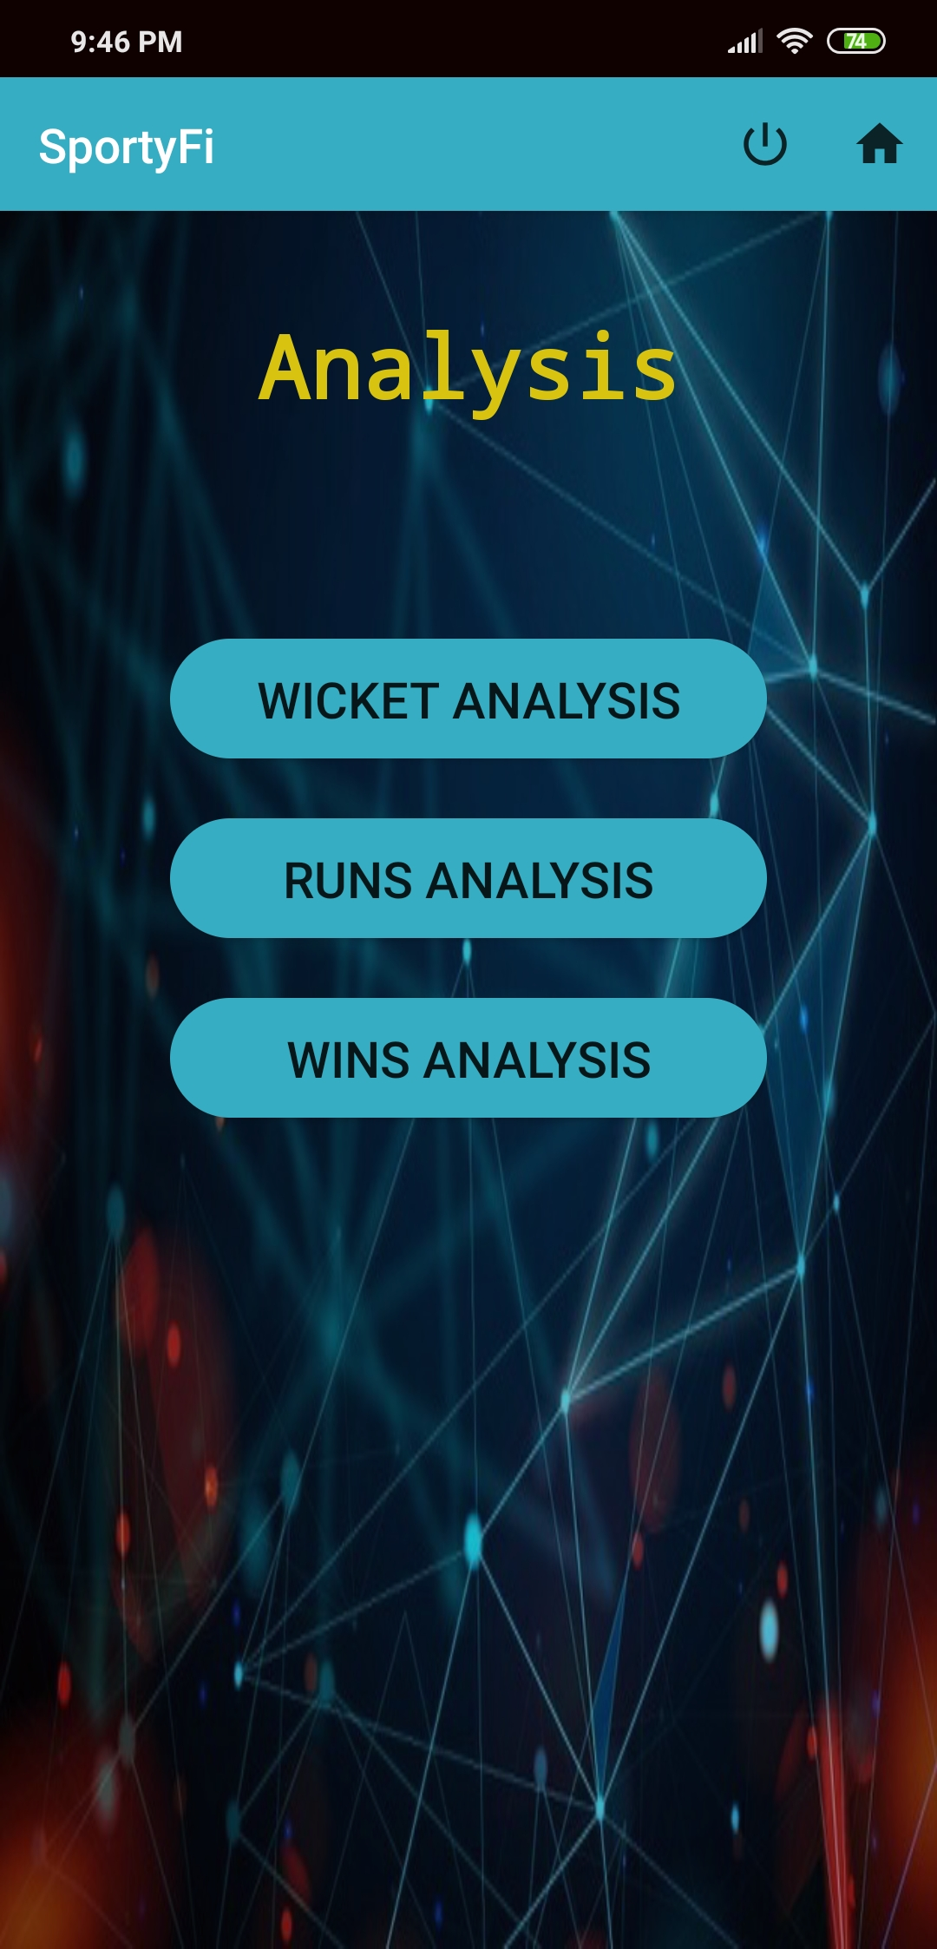
Analysis of cricket
Team analysis
1.Based on which team has taken most wickets.
2.Based on which team has taken most runs.
3.Based on which team won most matches.

Slide 50


Analysis of cricket
Team analysis
1.Which team has taken most wickets.
2.Which team has made most runs.

Slide 51

Analysis of cricket
Team analysis
3.Which has won most matches.

Slide 52

Analysis of cricket
Player analysis
1.Based on which player has taken most wickets.
2.Based on which player has made most runs.

Slide 53


Analysis of cricket
Player analysis
1.Wicket based
2.Run based

Slide 54
CONCLUSION
In this application,we have looked at some key concepts like schedules data,live scoreboard for not only one sport but for multiple sports,analysis of each player on team basis as well as on an individual basis.
Also team and player details will be provided to each other. This application will be helpful for schools and colleges for maintaining sports events.

Slide 55


